Slide 1
McStas Union components
What they are and how to use them
PRESENTED BY Mads Bertelsen
This project has received funding from the European Union’s Horizon 2020 research
and innovation programme under grant agreement No. 823852

Slide 2
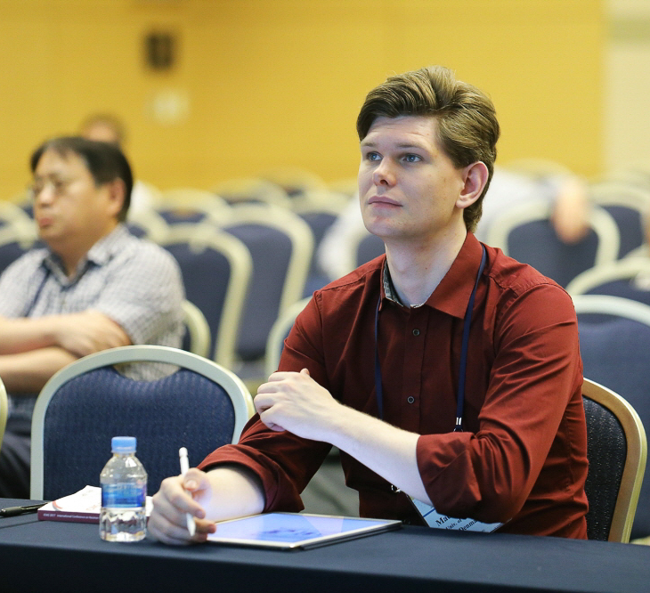
Introduction
Mads Bertelsen
Who am I?
Worked with McStas last 9 years, now McStas developer
PhD from University of Copenhagen under Kim Lefmann in 2017
Now Post Doc at ESS Data Managment and Software Centre, funded by PaNOSC and HighNESS
Writes software, happy when someone wants to use it and learn about my projects!
guide_bot
Automatic guide optimization given requirements and overall geometry (MATLAB)
Union components
Modular samples, multiple scattering within McStas
McStasScript
Flexible McStas Python API
This project has received funding from the European Union’s Horizon 2020 research and innovation programme under grant agreement No. 823852

Slide 3
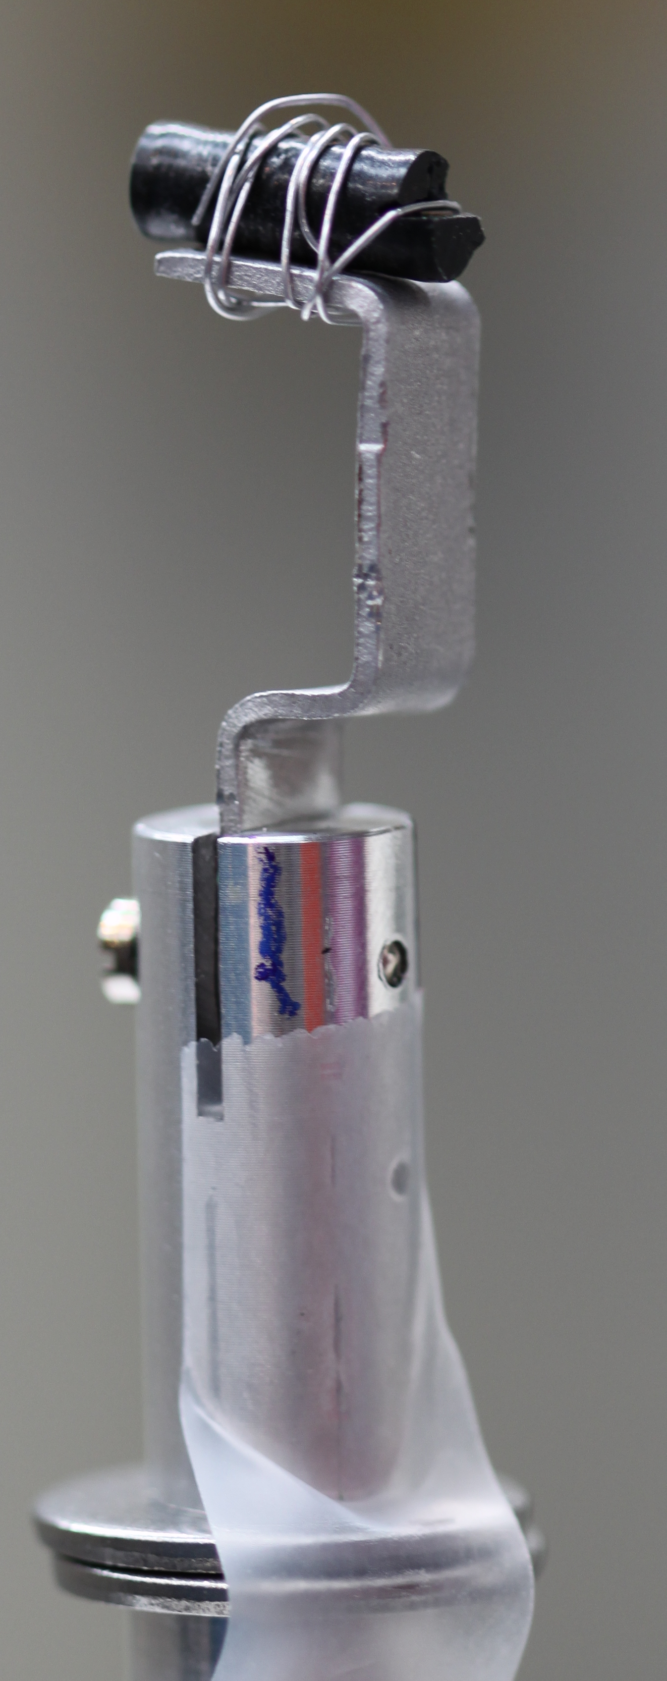
Introduction
Difficulties with realistic samples
Sample holders with complicated geometry
Consists of many different materials
No clear order in which neutrons would pass through
Could have co aligned crystals
Twinned crystals
It could all be in a sample environment
Photo by Pia Ray Jensen
This project has received funding from the European Union’s Horizon 2020 research and innovation programme under grant agreement No. 823852

Slide 4
Physics
Modular physics description
Combine simple physical processes
Incoherent scattering
Powder Bragg scattering
Single crystal Bragg scattering
Simple phonon
…
Create material definitions by combining an arbitrary number of these processes and an absorbation cross section
Processes
Materials
Incoherent_process
Al
Powder_process
Incoherent_process
Sample
Single_crystal_process
Incoherent_process
Inelastic sample
Single_crystal_process
NCrystal_process
This project has received funding from the European Union’s Horizon 2020 research and innovation programme under grant agreement No. 823852

Slide 5
Physics
Modular physics description
Processes
Materials
COMPONENT Al_incoherent = Incoherent_process( sigma = 4*0.0082, packing_factor=1, unit_cell_volume = 66.4) AT (0,0,0) ABSOLUTE
COMPONENT Al_powder = Powder_process( reflections = "Al.laz") AT (0,0,0) ABSOLUTE
COMPONENT Al = Union_make_material( my_absorption = 100*4*0.231/66.4, process_string = “Al_incoherent,Al_powder”) AT (0,0,0) ABSOLUTE
Incoherent_process
Al
Powder_process
Absorption given as inverse penetration depth
cross section per unit cell
my [1/m] =
unit cell volume
This project has received funding from the European Union’s Horizon 2020 research and innovation programme under grant agreement No. 823852

Slide 6
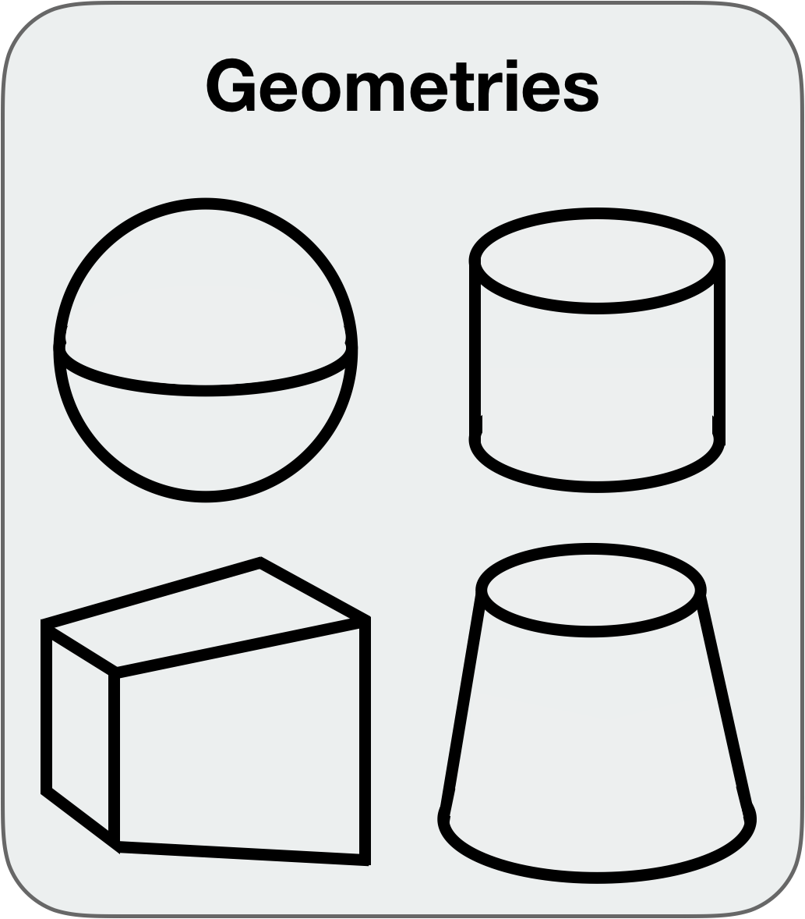
Geometry
Modular geoemtry
Construct the desired geometry from simple basic shapes
Sphere
Cylinder
Box
Cone
CAD model (stl files)
Assign each geometry a material
Incoherent_process
Al
Powder_process
Incoherent_process
Sample
Single_crystal_process
Incoherent_process
Inelastic sample
Single_crystal_process
NCrystal_process
This project has received funding from the European Union’s Horizon 2020 research and innovation programme under grant agreement No. 823852

Slide 7
Geometry
Priority
Aluminium priority = 8.2
Each geometry is given a priority
When two geometries overlap, the overlapping region has the material of the highest priority
This allows the user to create complex geometries
Vanadium priority = 5.1
This project has received funding from the European Union’s Horizon 2020 research and innovation programme under grant agreement No. 823852

Slide 8
Geometry
Priority
Each geometry is given a priority
When two geometries overlap, the overlapping region has the material of the highest priority
This allows the user to create complex geometries
This project has received funding from the European Union’s Horizon 2020 research and innovation programme under grant agreement No. 823852

Slide 9
Geometry
Modular geometry
COMPONENT cryostat_shell = Union_cylinder( radius = 0.15, height = 0.4, priority = 10, material_string = "Al") AT (0,0,0) RELATIVE target ROTATED (0,0,0) RELATIVE target
COMPONENT cryostat_vacuum = Union_cylinder( radius = 0.147,height = 0.39, priority = 11, material_string = "Vacuum") AT (0,0,0) RELATIVE target ROTATED (0,0,0) RELATIVE target
Al
Vacuum
This project has received funding from the European Union’s Horizon 2020 research and innovation programme under grant agreement No. 823852

Slide 10
Union master
Where the simulation actually happens
All components discussed doesn’t actually perform any simulation
Process and geometry components describe the system to be simulated
The Union_master component performs the simulation
A Union_master must be inserted, and will simulate all Union geometry components defined so far
No inputs are necessary, as all the information is already in the processes and geometry
COMPONENT master = Union_master() AT (0,0,0) ABSOLUTE
This project has received funding from the European Union’s Horizon 2020 research and innovation programme under grant agreement No. 823852

Slide 11
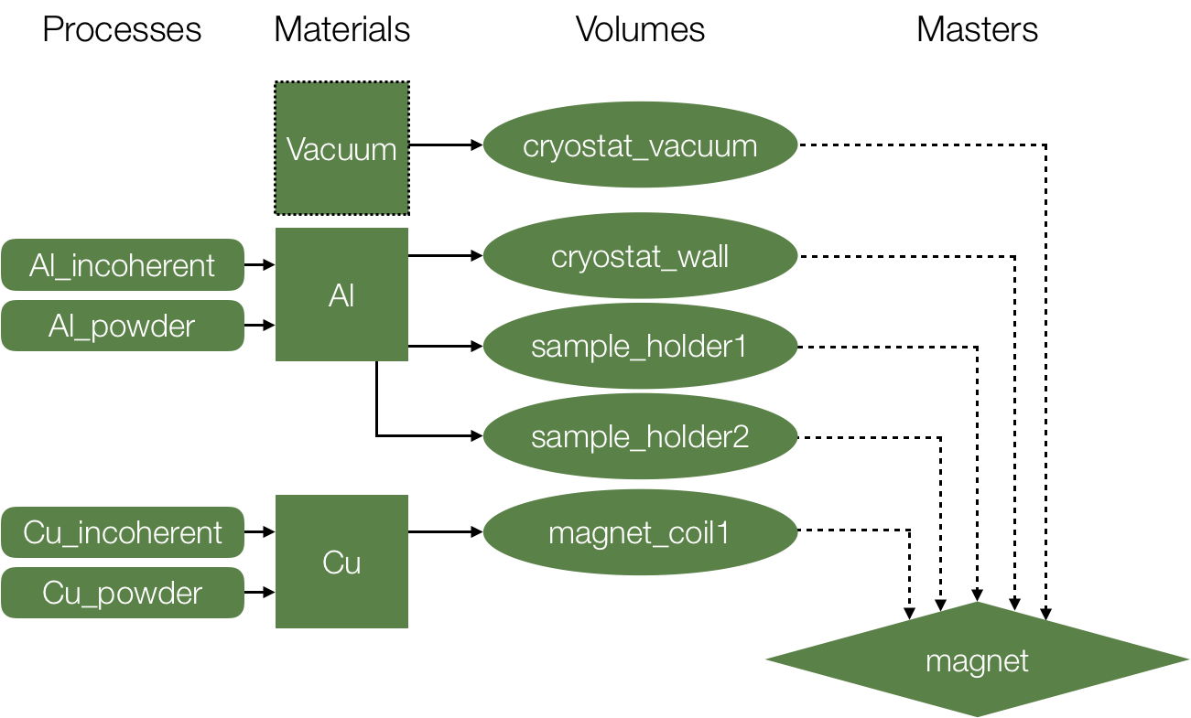
Union master
Overview of a Union setup
This project has received funding from the European Union’s Horizon 2020 research and innovation programme under grant agreement No. 823852

Slide 12
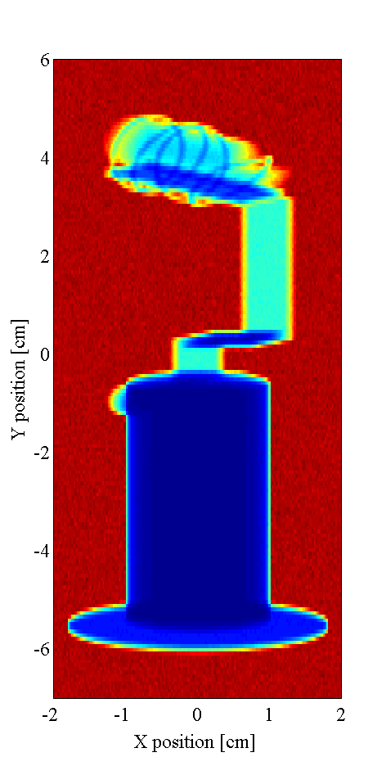
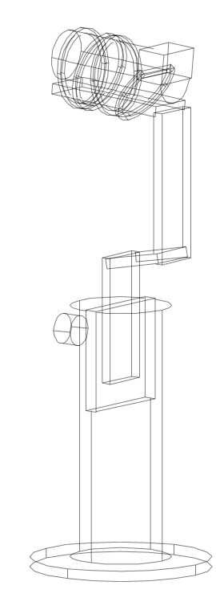
Introduction
How does this improve the situation?
Sample holders with complicated geometry
Consists of many different materials
No clear order in which neutrons would pass through
Could have co aligned crystals
Twinned crystals
It could all be in a sample environment
Photo by Pia Ray Jensen
This project has received funding from the European Union’s Horizon 2020 research and innovation programme under grant agreement No. 823852

Slide 13
Multiple scattering
Logic in McStas instrument
Multiple scattering handled in Union_master component
Neutron handed back to instrument component sequence
Simulated 3D space
Instrument file
This project has received funding from the European Union’s Horizon 2020 research and innovation programme under grant agreement No. 823852

Slide 14
Multiple scattering
Logic in McStas instrument
Multiple scattering handled in Union_master component
Neutron handed back to instrument component sequence
Ray can go to geometries in any order
Simulated 3D space
Instrument file
This project has received funding from the European Union’s Horizon 2020 research and innovation programme under grant agreement No. 823852

Slide 15
Multiple scattering
Logic in McStas instrument
Multiple scattering handled in Union_master component
Neutron handed back to instrument component sequence
Ray can go to geometries in any order
Internal logic network reduce number of intersection calculations, improving execution speed
Simulated 3D space
Instrument file
This project has received funding from the European Union’s Horizon 2020 research and innovation programme under grant agreement No. 823852

Slide 16
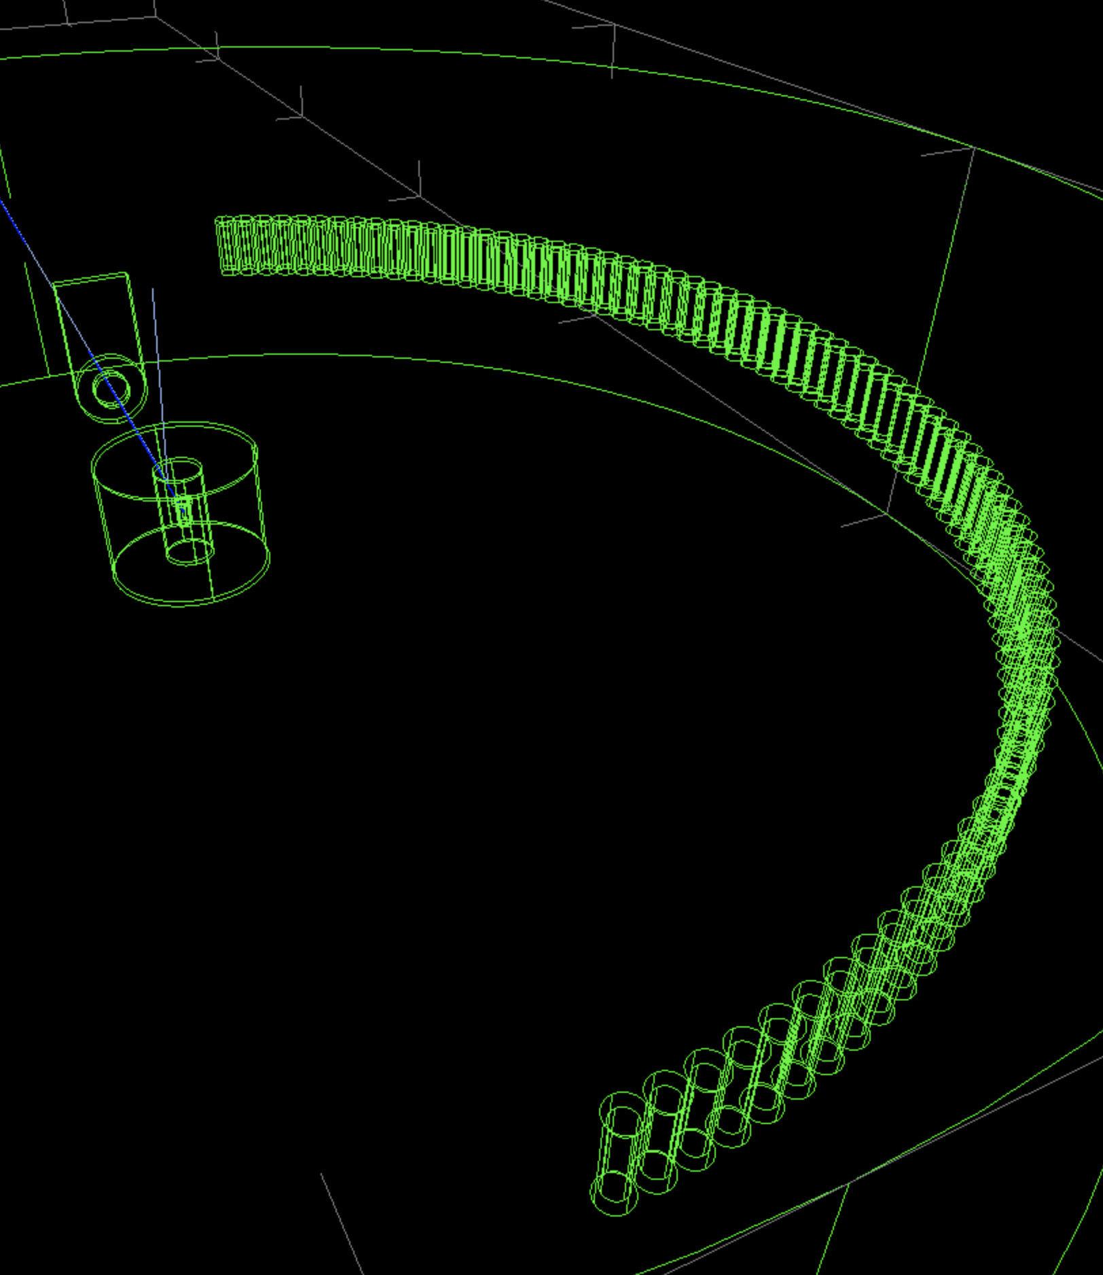
2
Demonstration

Slide 17
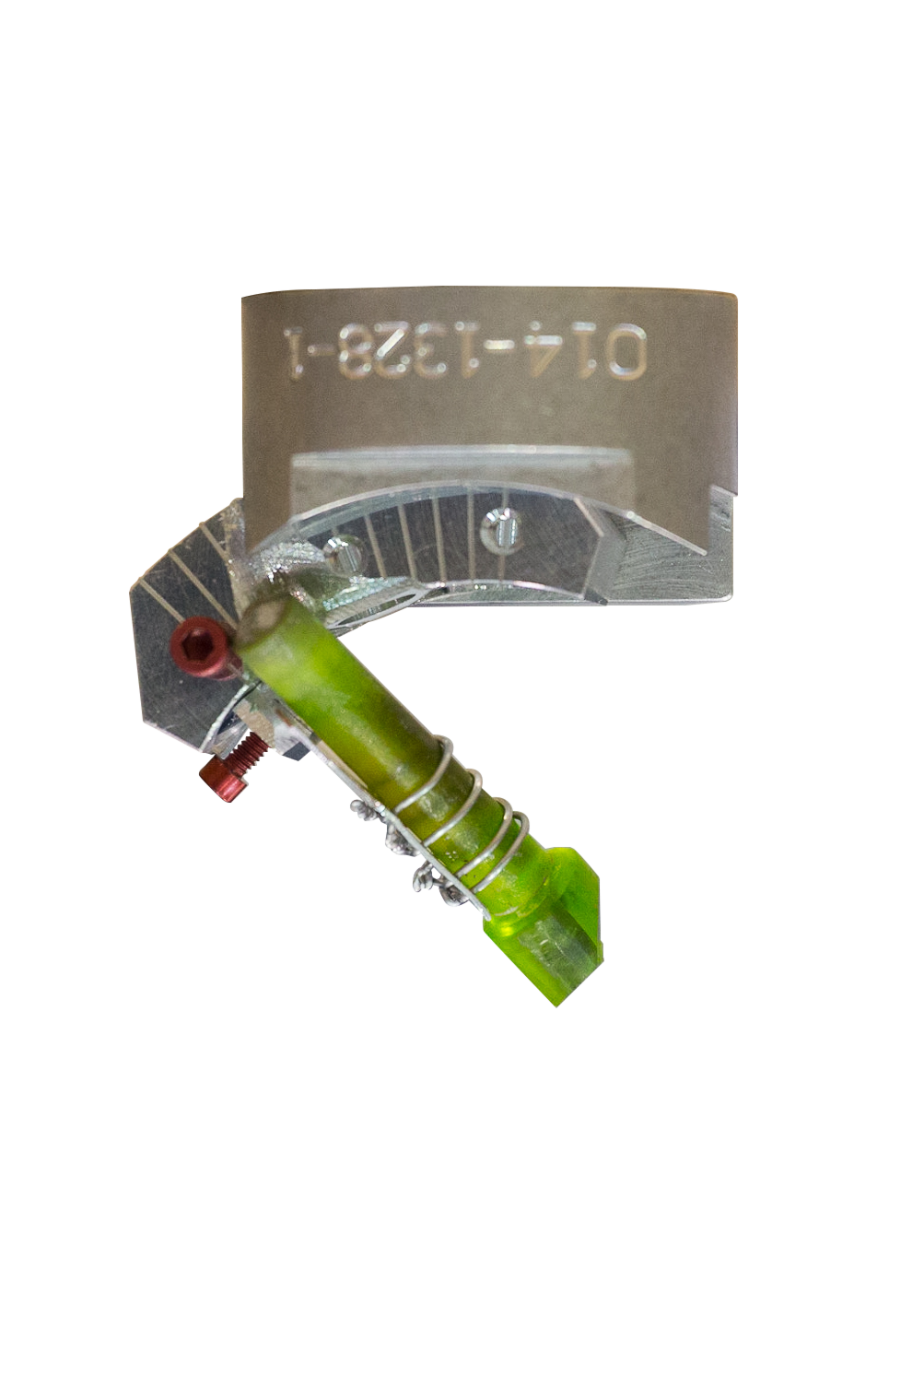
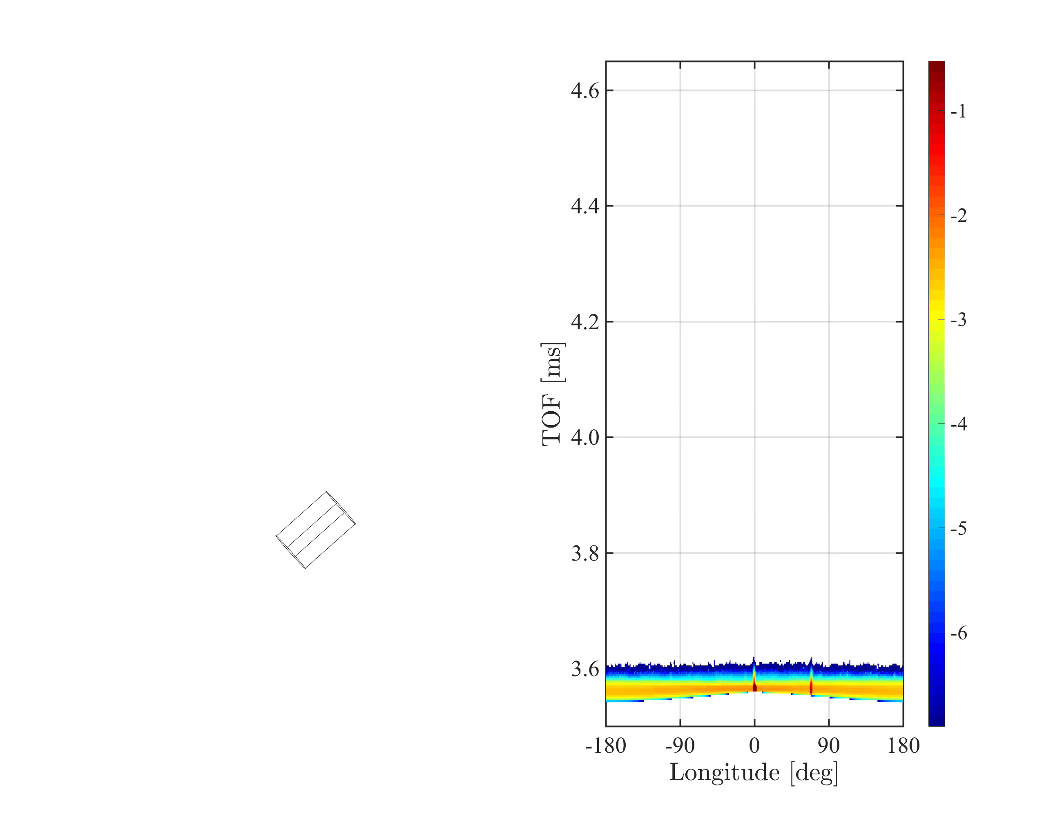
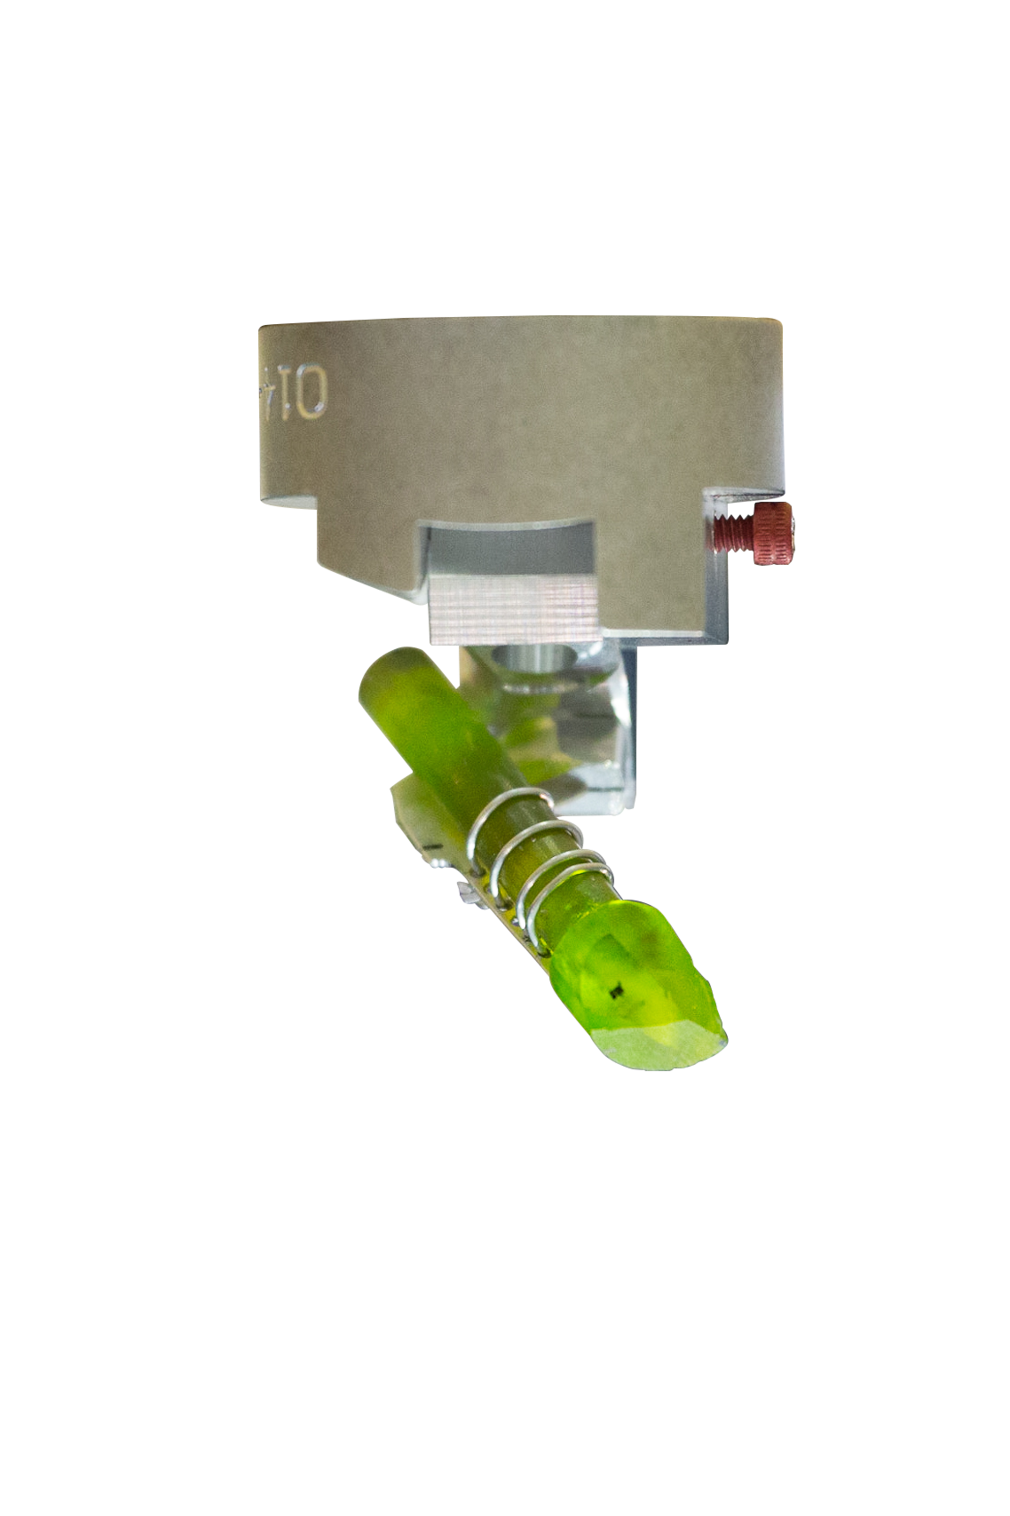
Demonstration
log(I)
5 meV beam
This project has received funding from the European Union’s Horizon 2020 research and innovation programme under grant agreement No. 823852

Slide 18
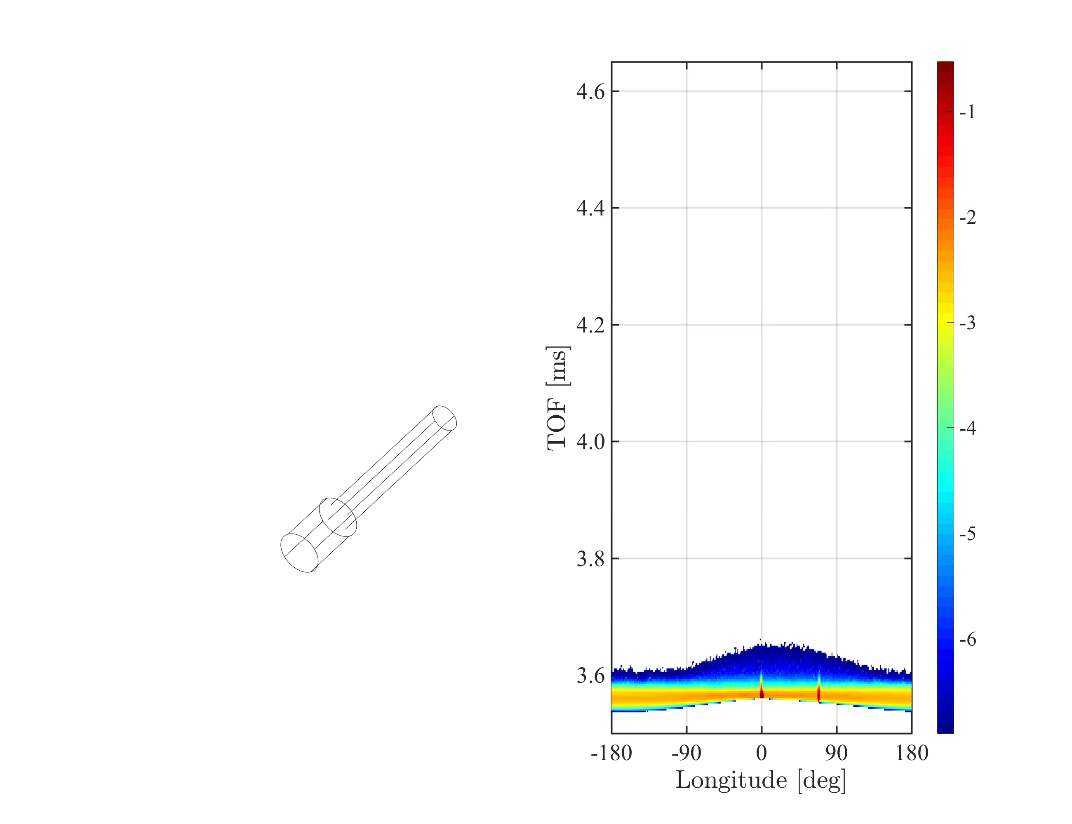
Demonstration
log(I)
This project has received funding from the European Union’s Horizon 2020 research and innovation programme under grant agreement No. 823852

Slide 19
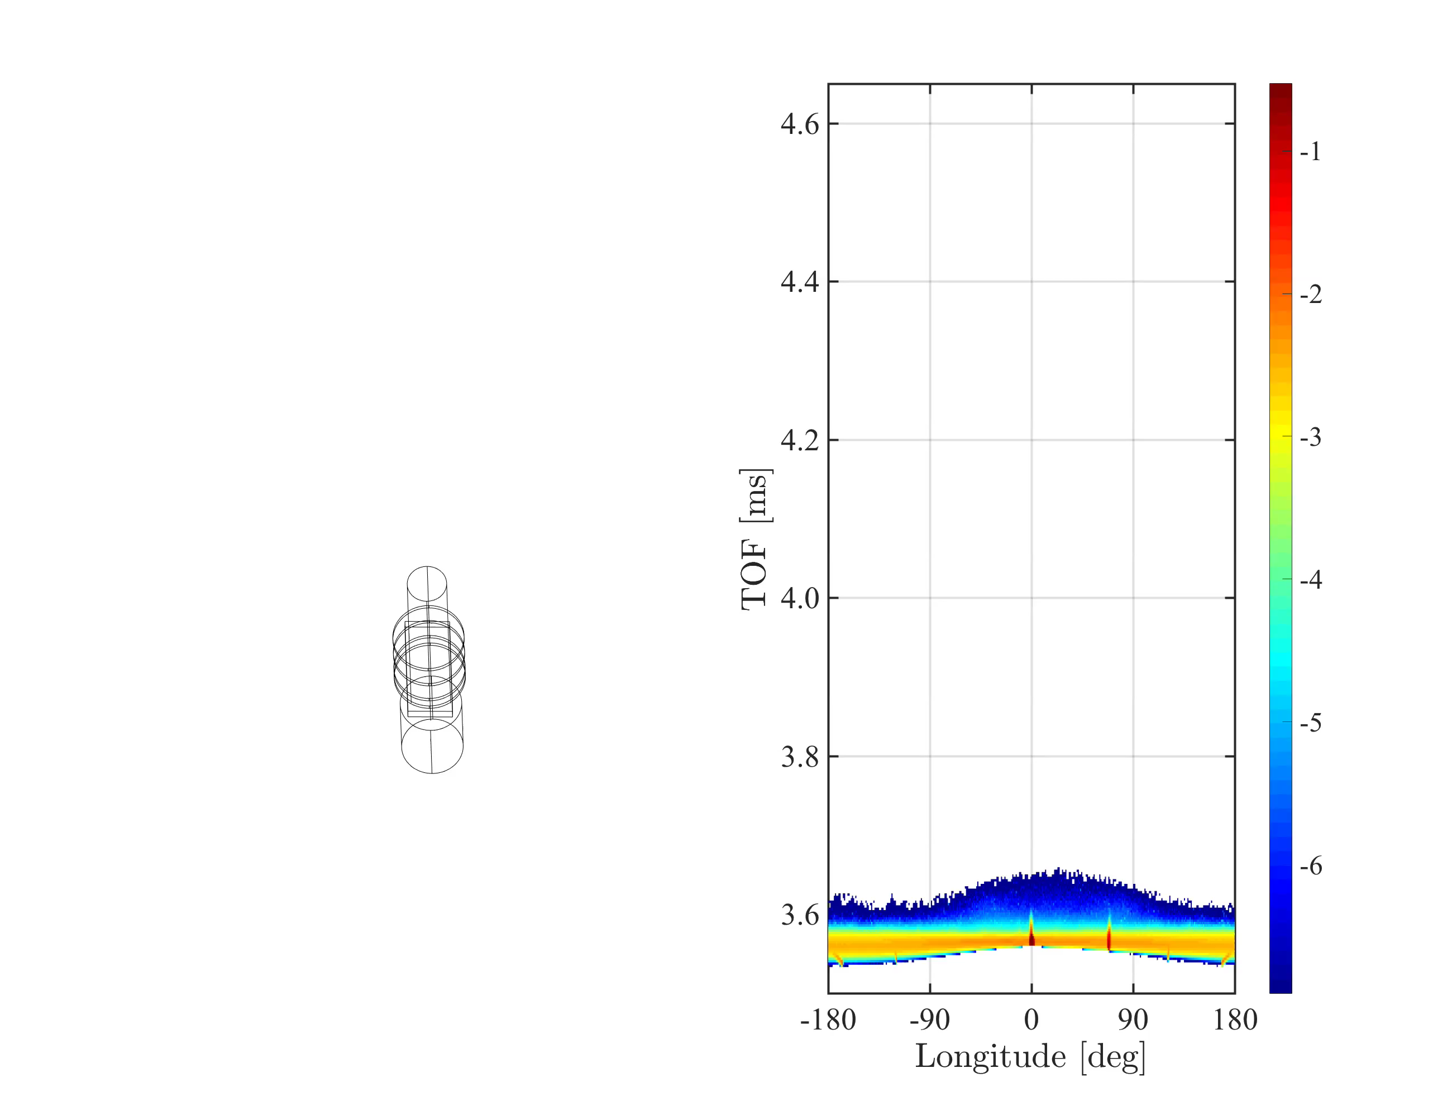
Demonstration
log(I)
This project has received funding from the European Union’s Horizon 2020 research and innovation programme under grant agreement No. 823852

Slide 20

Demonstration
log(I)
This project has received funding from the European Union’s Horizon 2020 research and innovation programme under grant agreement No. 823852

Slide 21
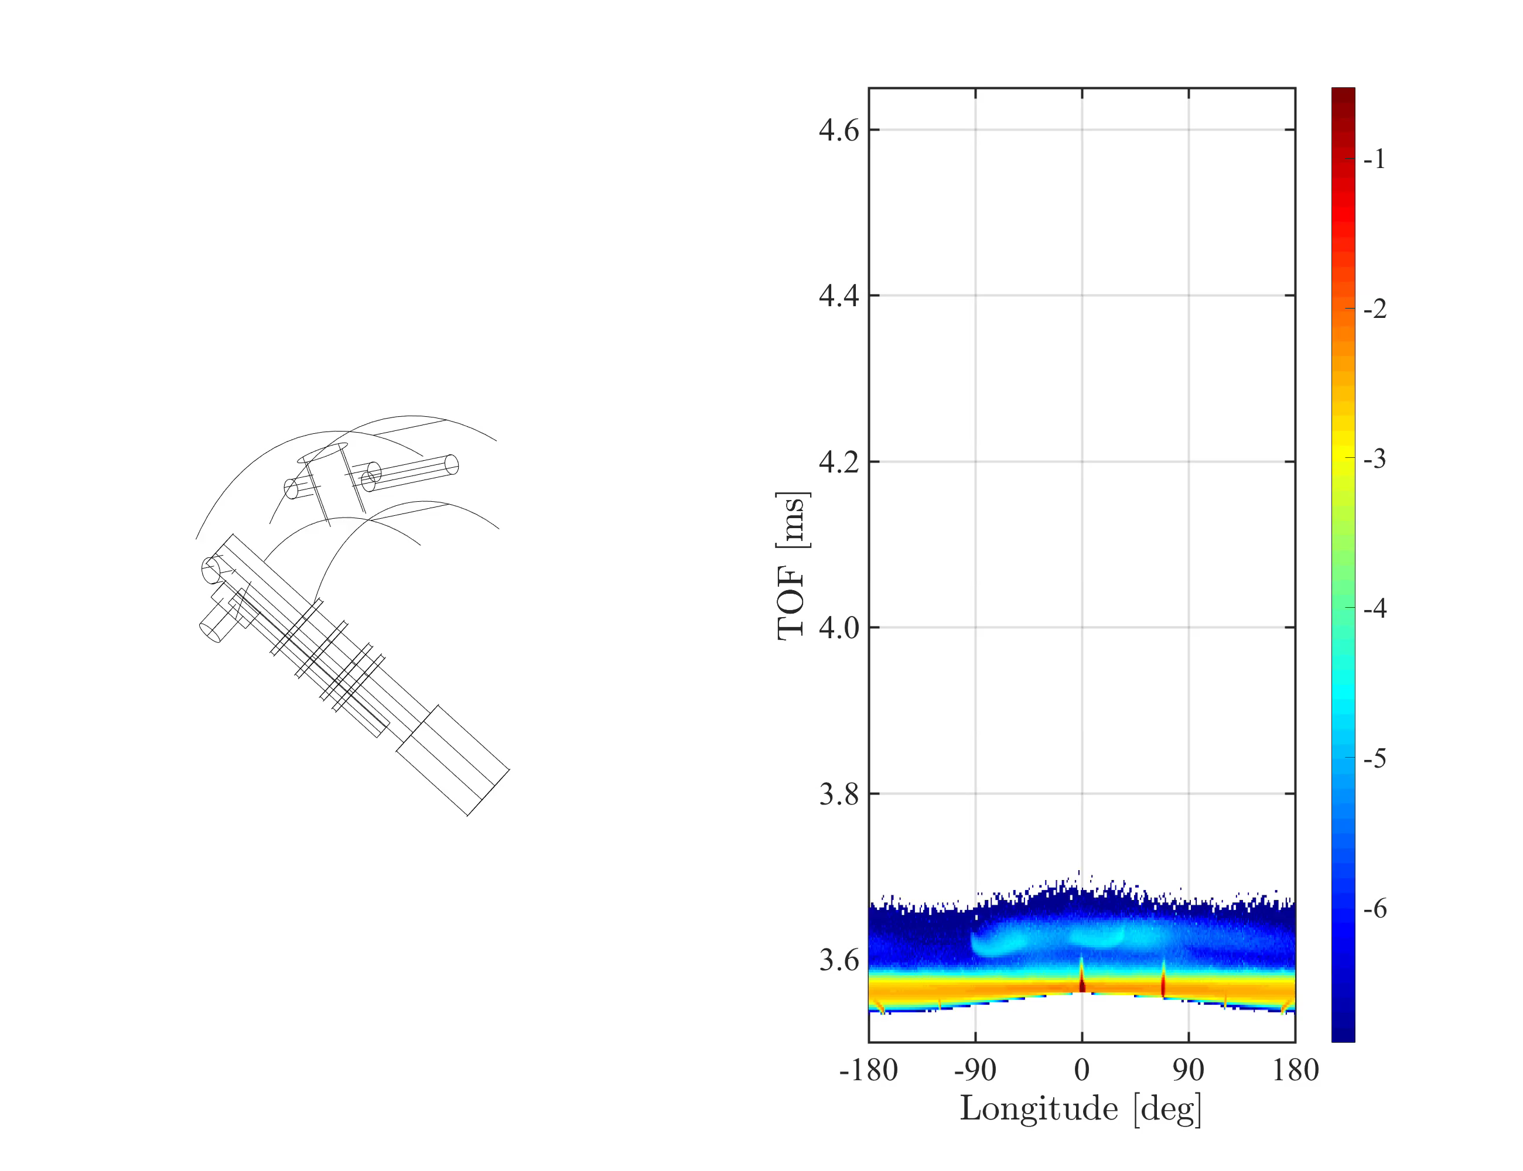
Demonstration
log(I)
This project has received funding from the European Union’s Horizon 2020 research and innovation programme under grant agreement No. 823852

Slide 22
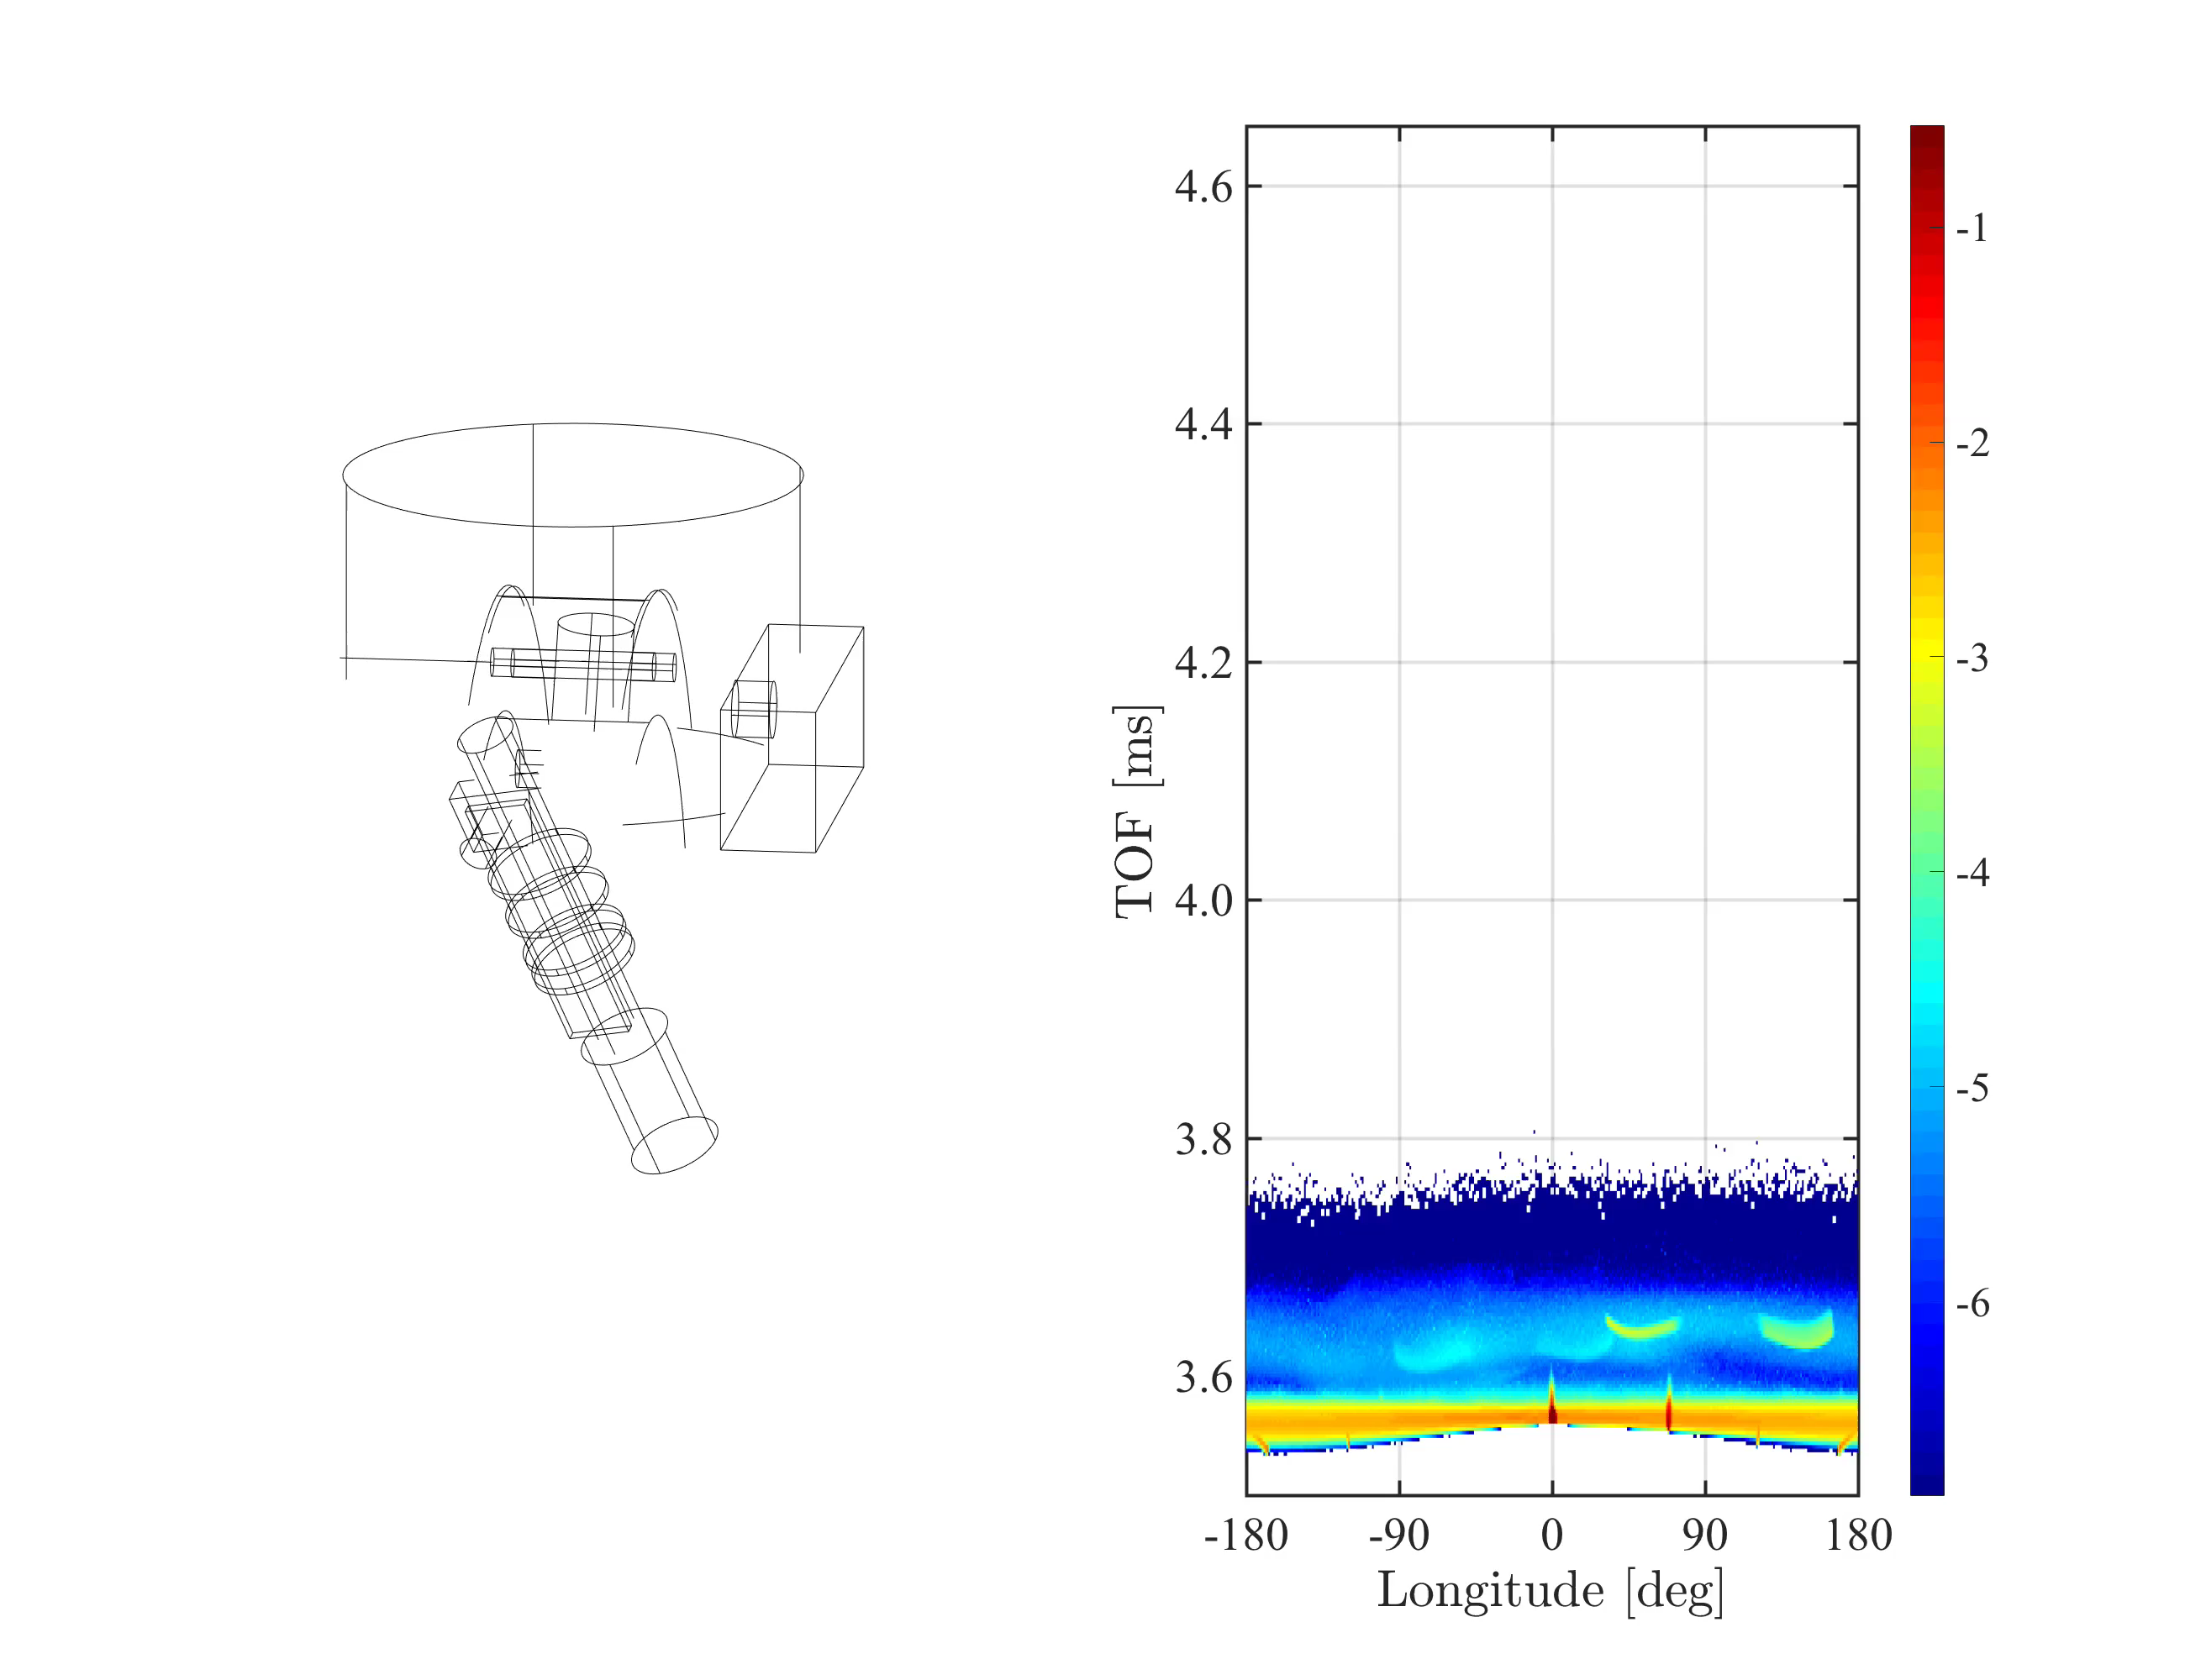
Demonstration
log(I)
This project has received funding from the European Union’s Horizon 2020 research and innovation programme under grant agreement No. 823852

Slide 23
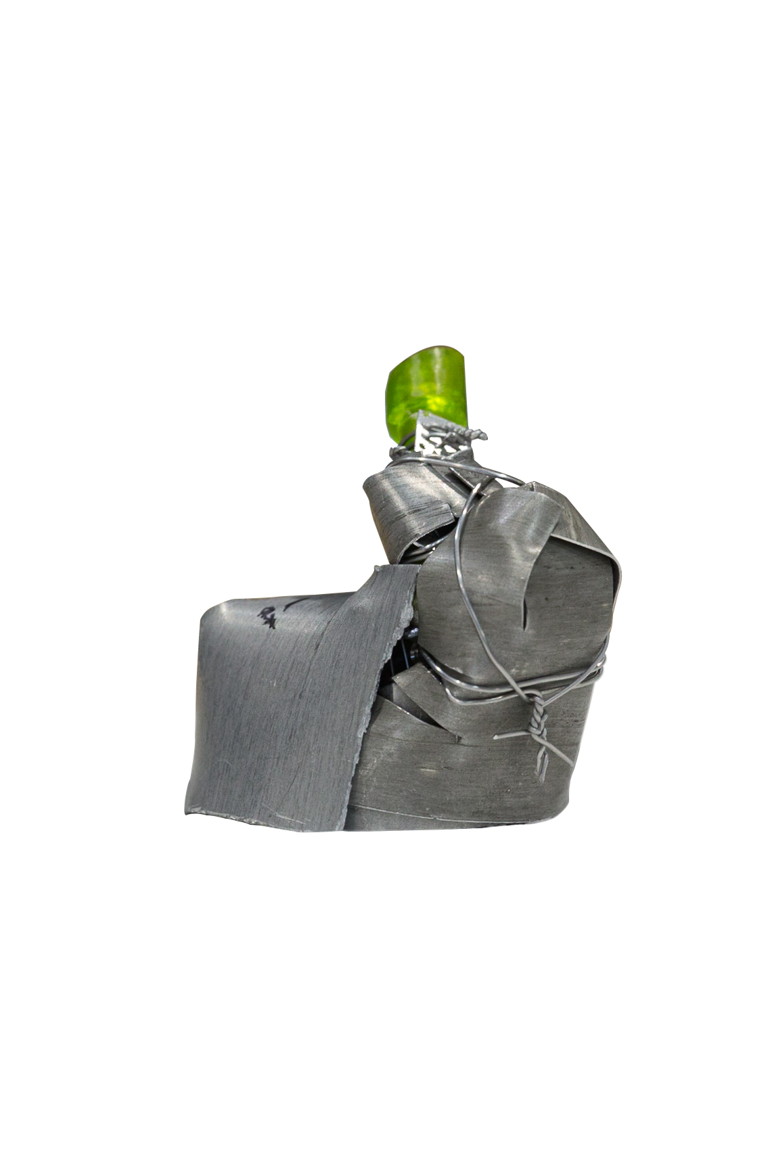
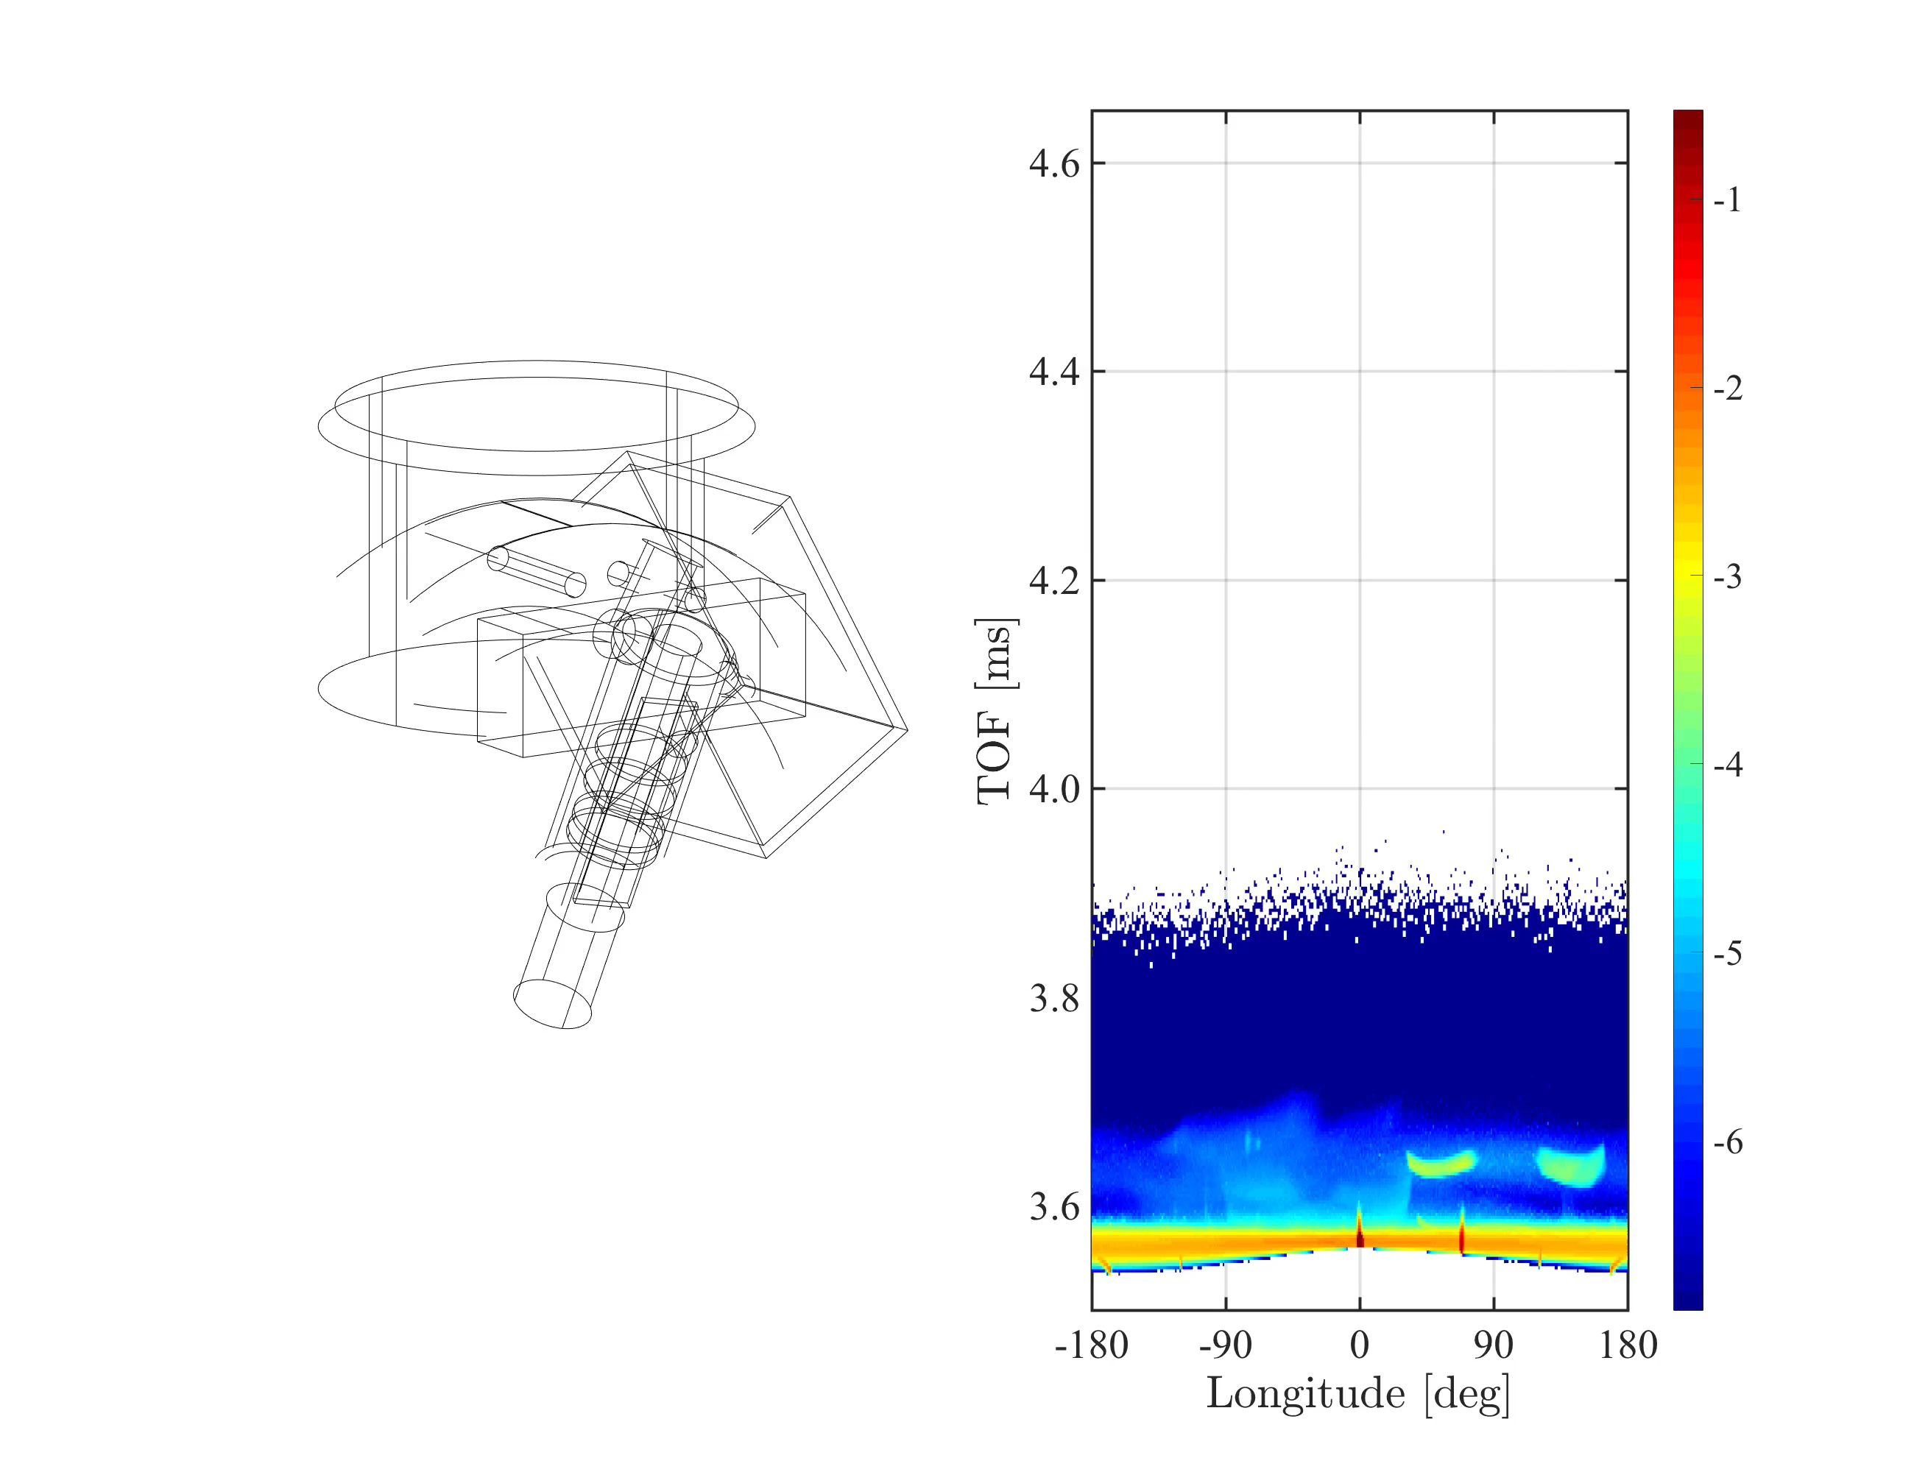
Demonstration
log(I)
This project has received funding from the European Union’s Horizon 2020 research and innovation programme under grant agreement No. 823852

Slide 24
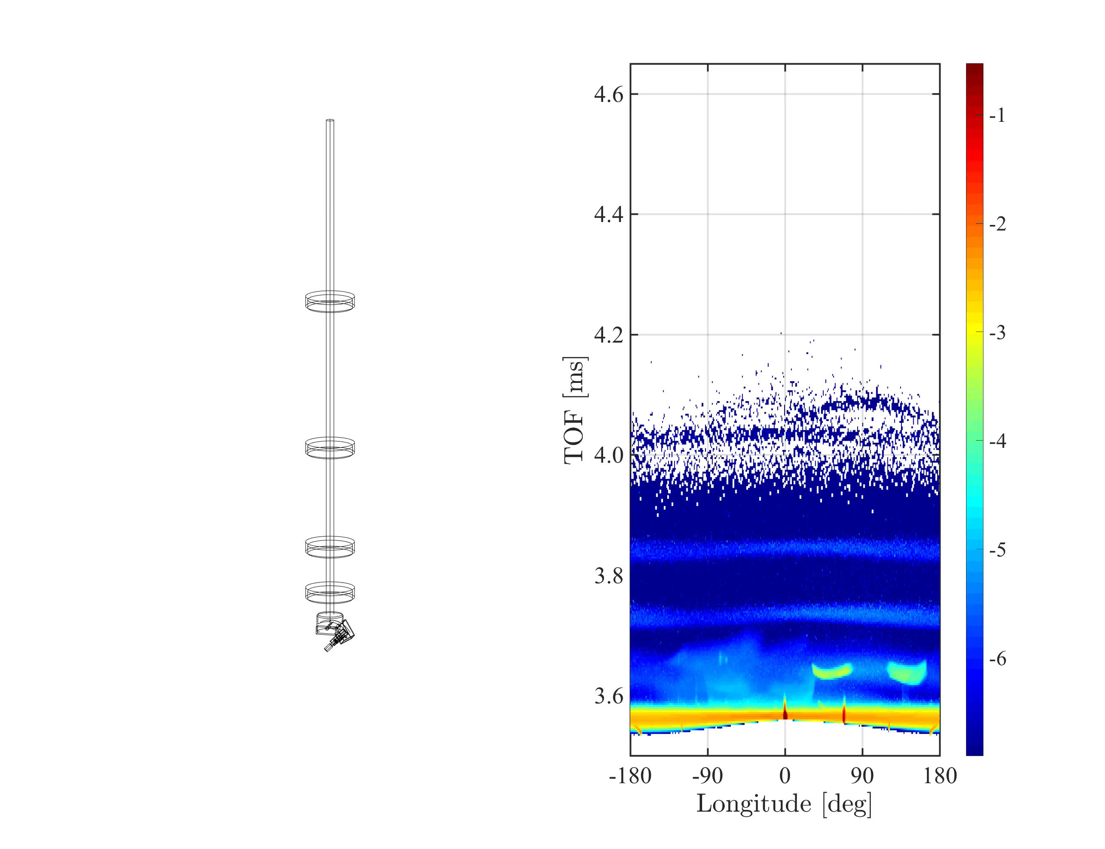
Demonstration
log(I)
This project has received funding from the European Union’s Horizon 2020 research and innovation programme under grant agreement No. 823852

Slide 25
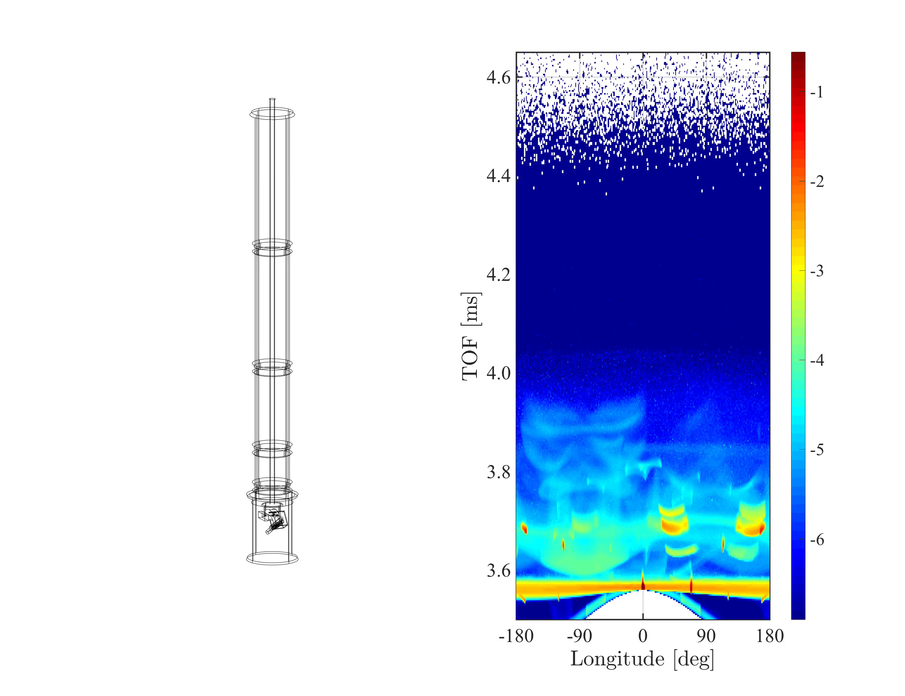
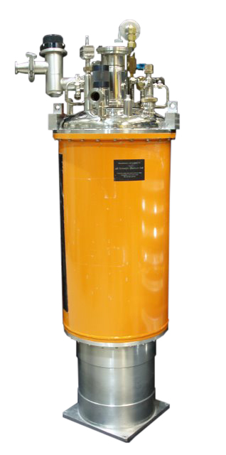
Demonstration
log(I)
This project has received funding from the European Union’s Horizon 2020 research and innovation programme under grant agreement No. 823852

Slide 26
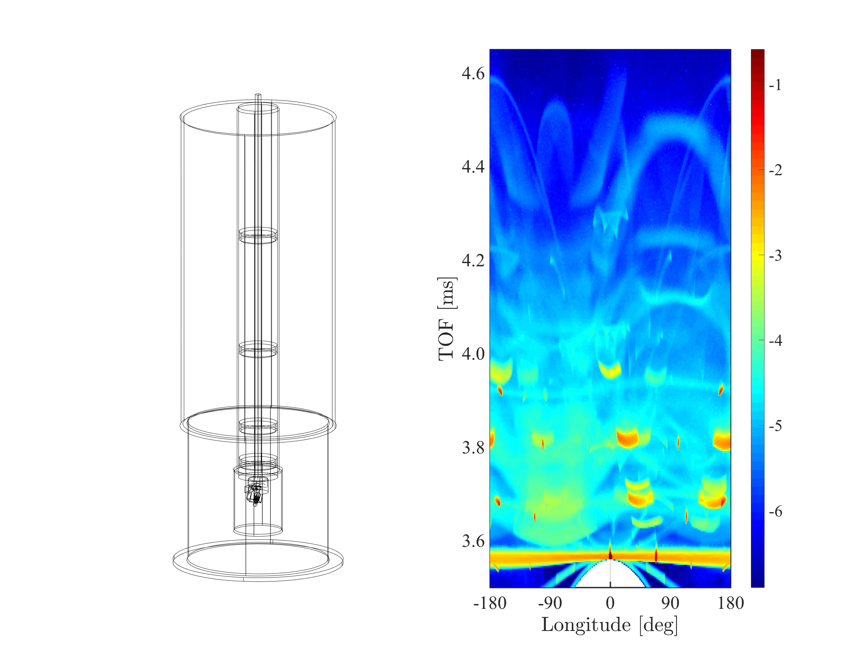
Demonstration
log(I)
This project has received funding from the European Union’s Horizon 2020 research and innovation programme under grant agreement No. 823852

Slide 27

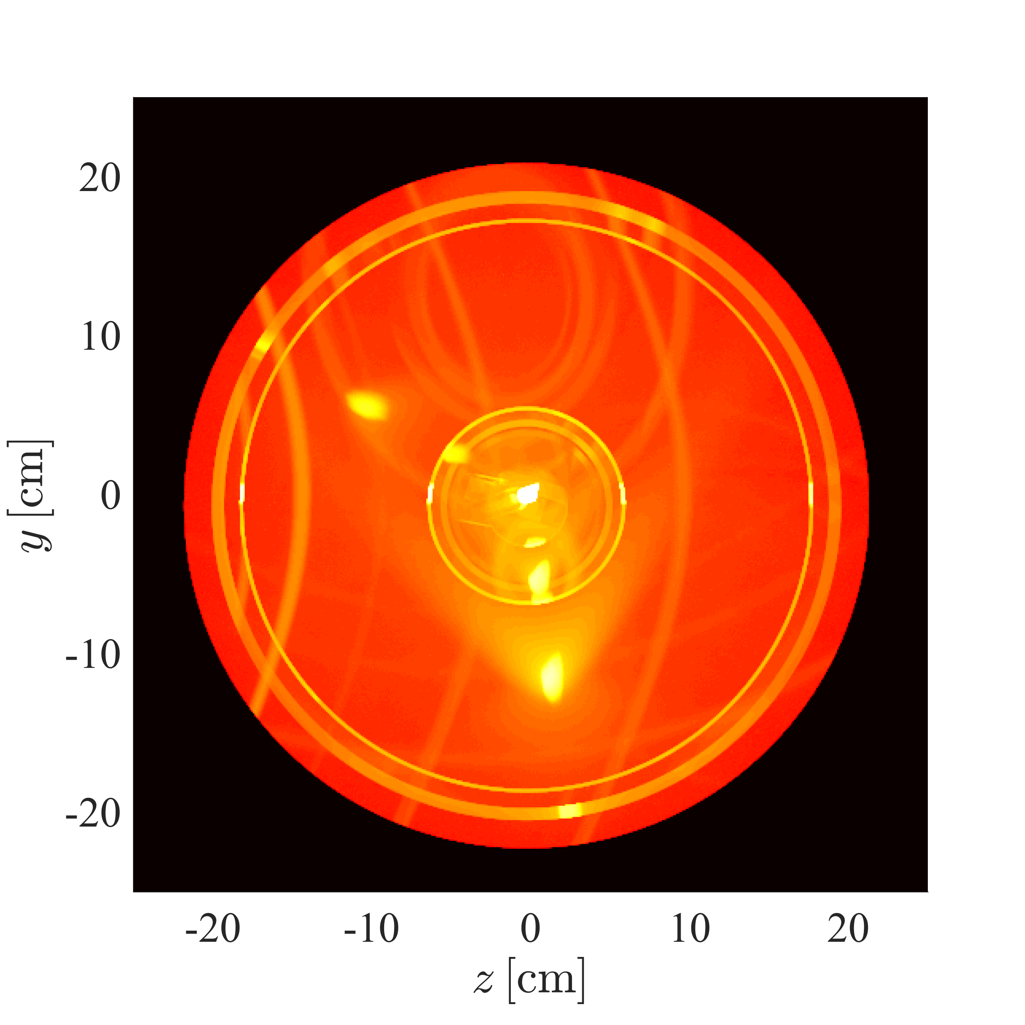
Demonstration
log(I)
This project has received funding from the European Union’s Horizon 2020 research and innovation programme under grant agreement No. 823852

Slide 28
Logger components
Recording information during simulation
Loggers can be used to understand what is going on during simulation
Can either log everything, or be attached to a geometry or process
Physics
Geometry
Logging
Incoherent_process
Al
Loggers Records at scattering event
Absorption loggers Records at absorption event
Can be attached to: Geometries Processes
Powder_process
Incoherent_process
Sample
Single_crystal_process
Incoherent_process
Inelastic sample
Single_crystal_process
NCrystal_process
This project has received funding from the European Union’s Horizon 2020 research and innovation programme under grant agreement No. 823852

Slide 29
Logger components
Recording information during simulation
All loggers record something at scattering or absorption
They can all be set to only log certain scattering order
List of loggers
Union_logger_1D
Union_logger_2DQ
Union_logger_2D_kf
Union_logger_2D_kf_time
Union_logger_2D_space
Union_logger_2D_space_time
Union_logger_3D_space
List of absorption loggers
Union_abs_logger_1D_space
Union_abs_logger_1D_space_event
Union_abs_logger_1D_space_tof
Union_abs_logger_1D_space_tof_to_lambda
Union_abs_logger_2D_space
Union_abs_logger_event

Slide 30
Logger components
Recording information during simulation
Need to understand the simulation
Record information during scattering
Here spatial distribution of scattered intensity from above
COMPONENT scattering_zx = Union_logger_2D_space( D_direction_1="z", D1_min=-0.15, D1_max=0.15, n1=300, D_direction_2="x", D2_min=-0.15, D2_max=0.15, n2=300, filename="scattering_zx.dat") AT (0,0,0) RELATIVE sample_position

Slide 31
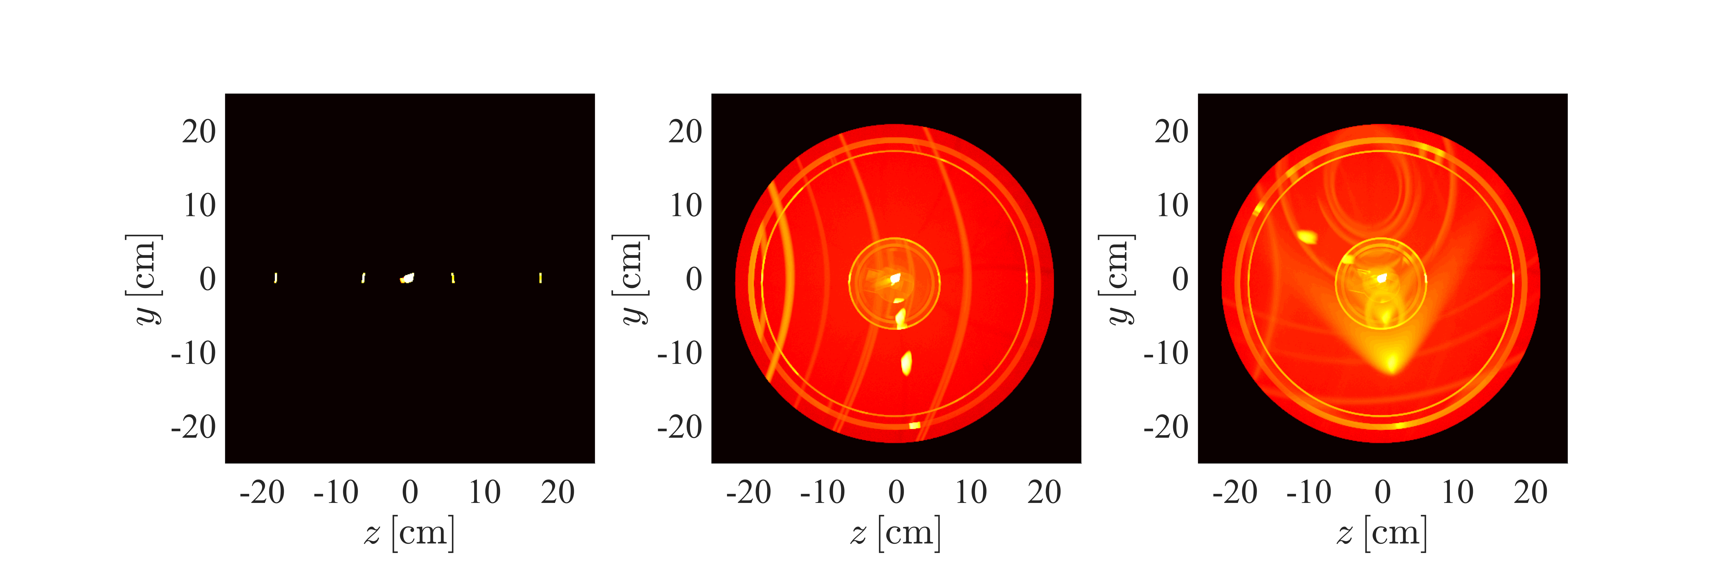
Logger components
Recording information during simulation
All
A specific scattering order can be shown
Improves understanding of what occured
1
2
3

Slide 32
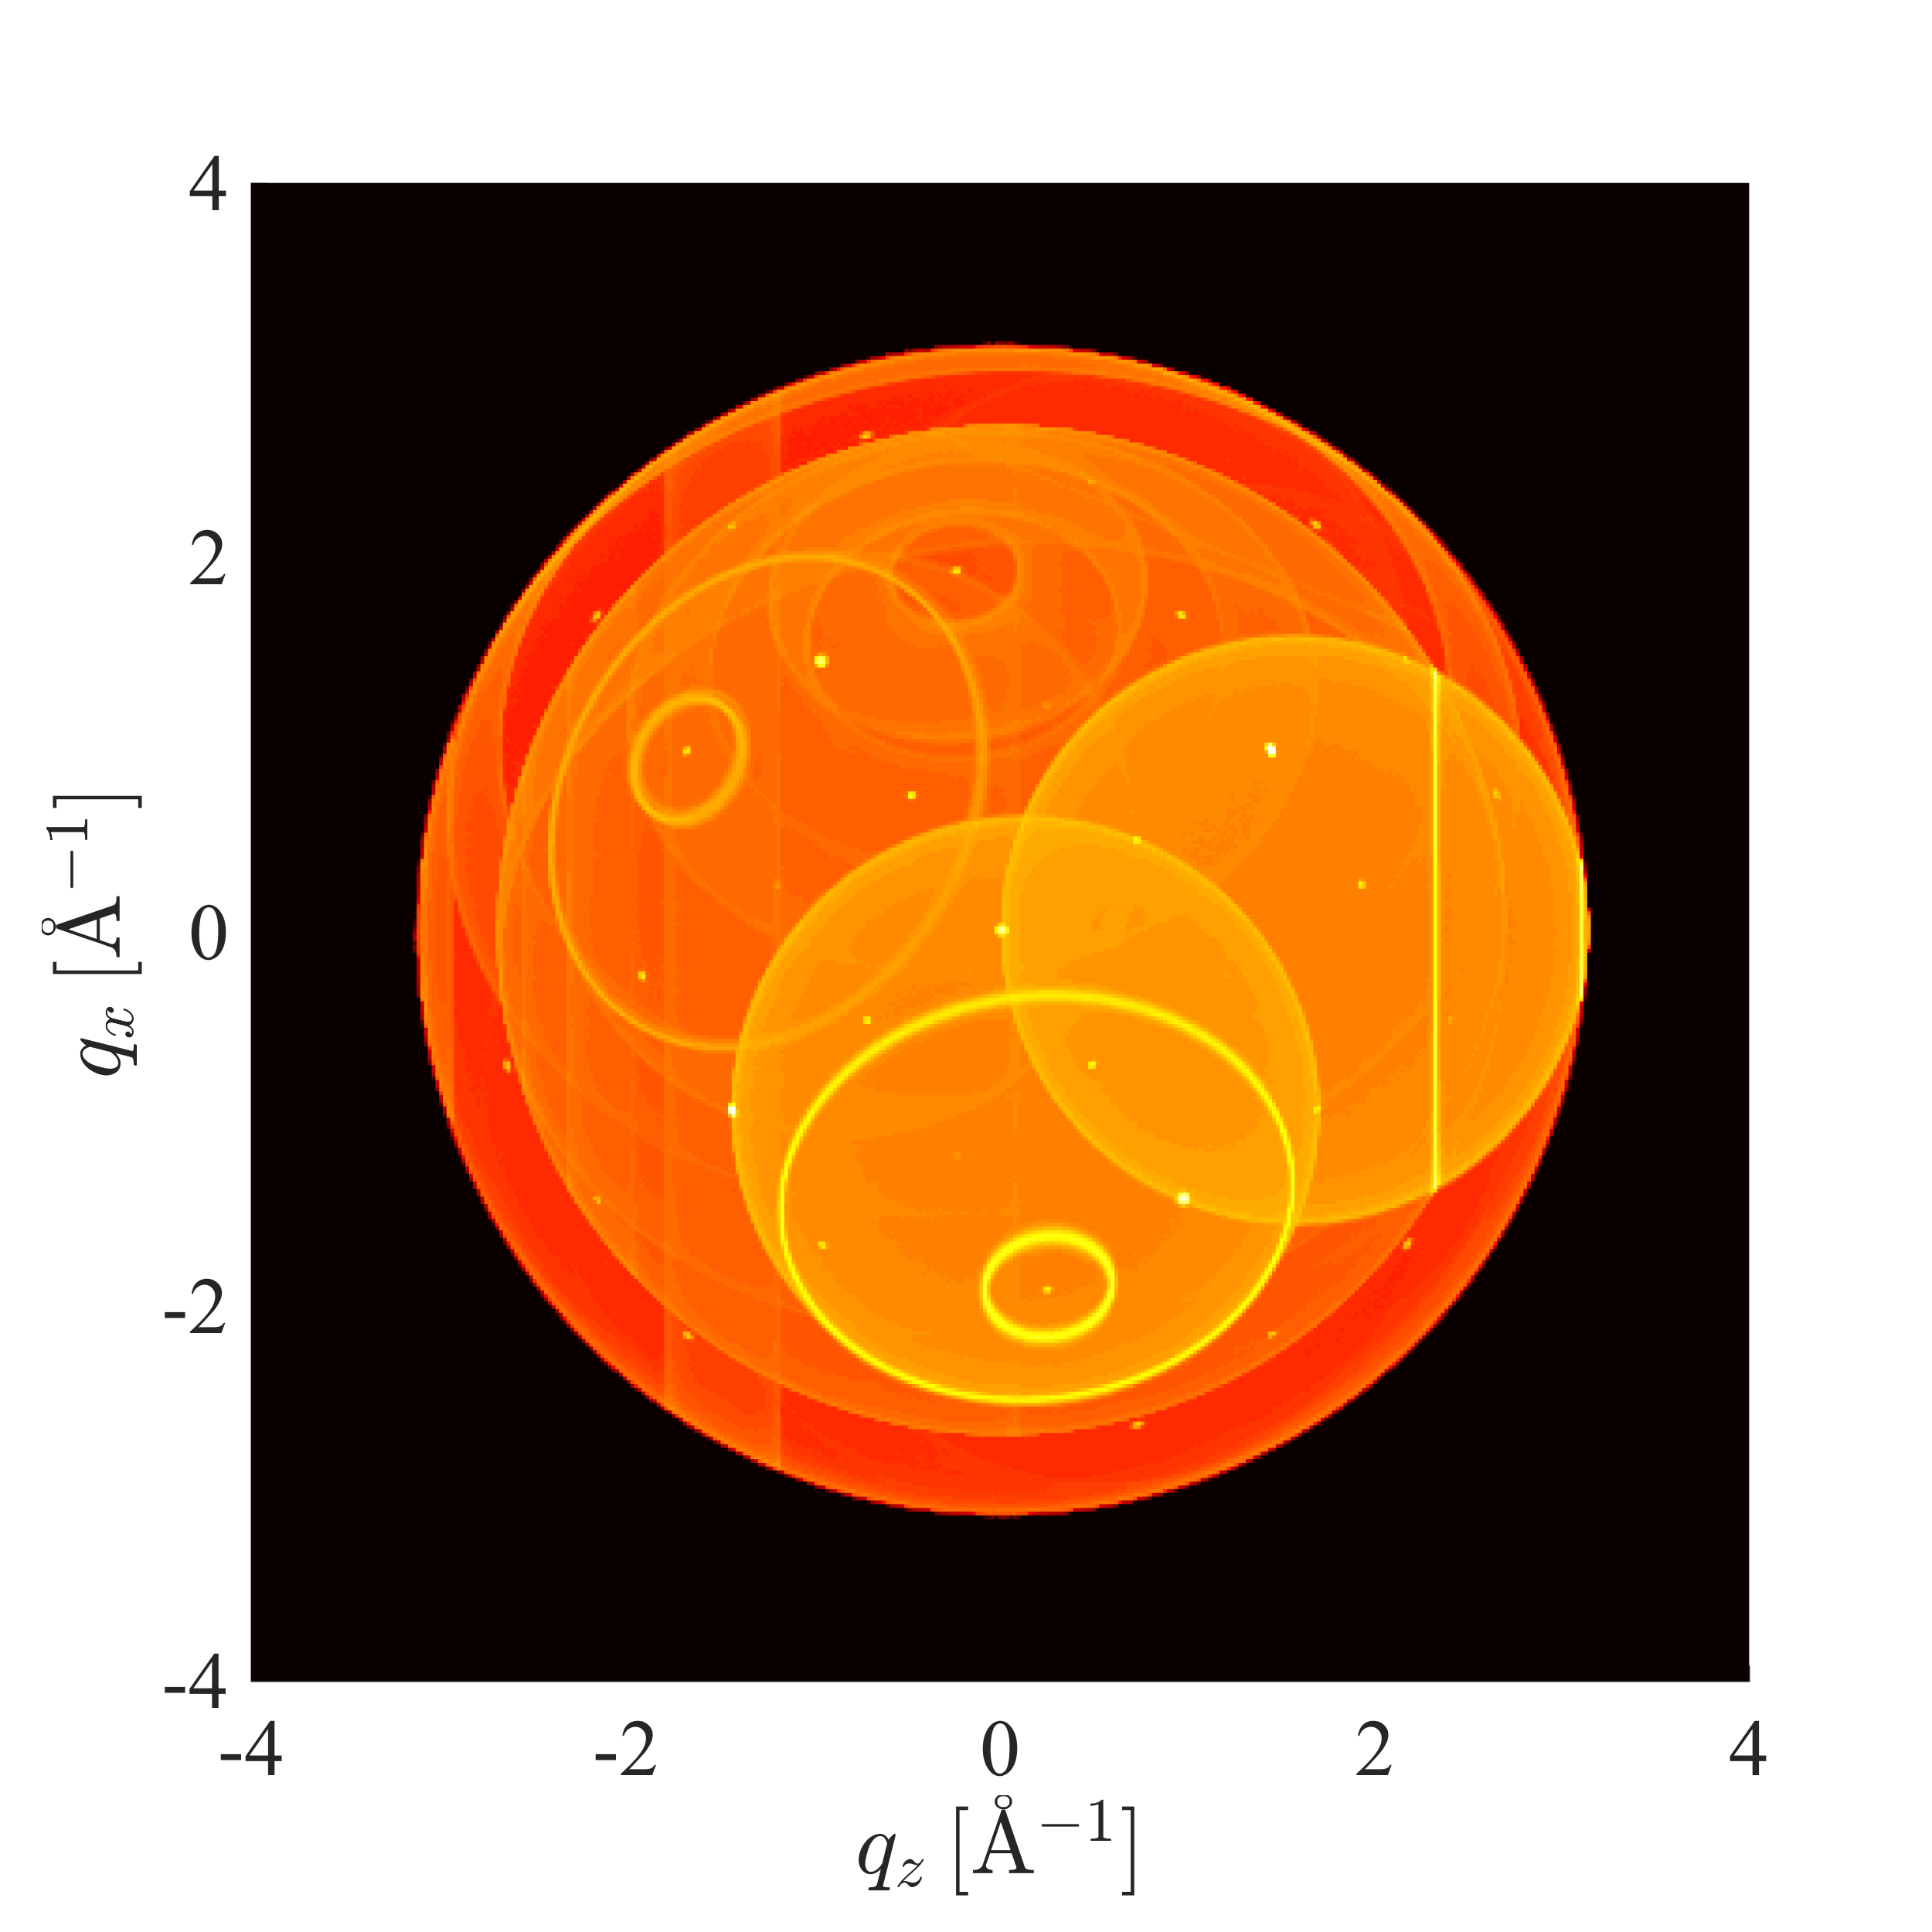
Logger components
Recording information during simulation
Here the scattering vector is recorded
Visible Bragg peaks and Debye Scherrer cones

Slide 33
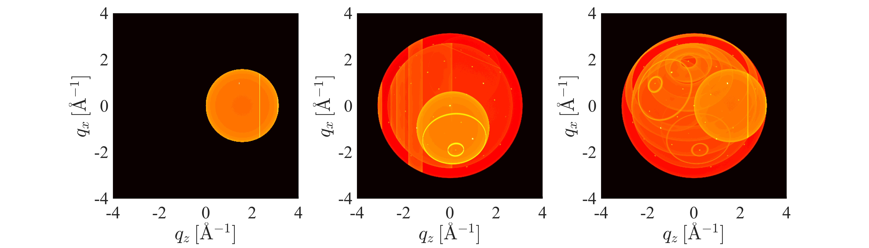
Logger components
Recording information during simulation
All
A specific scattering order can be shown
Improves understanding of what occured
1
2
3

Slide 34
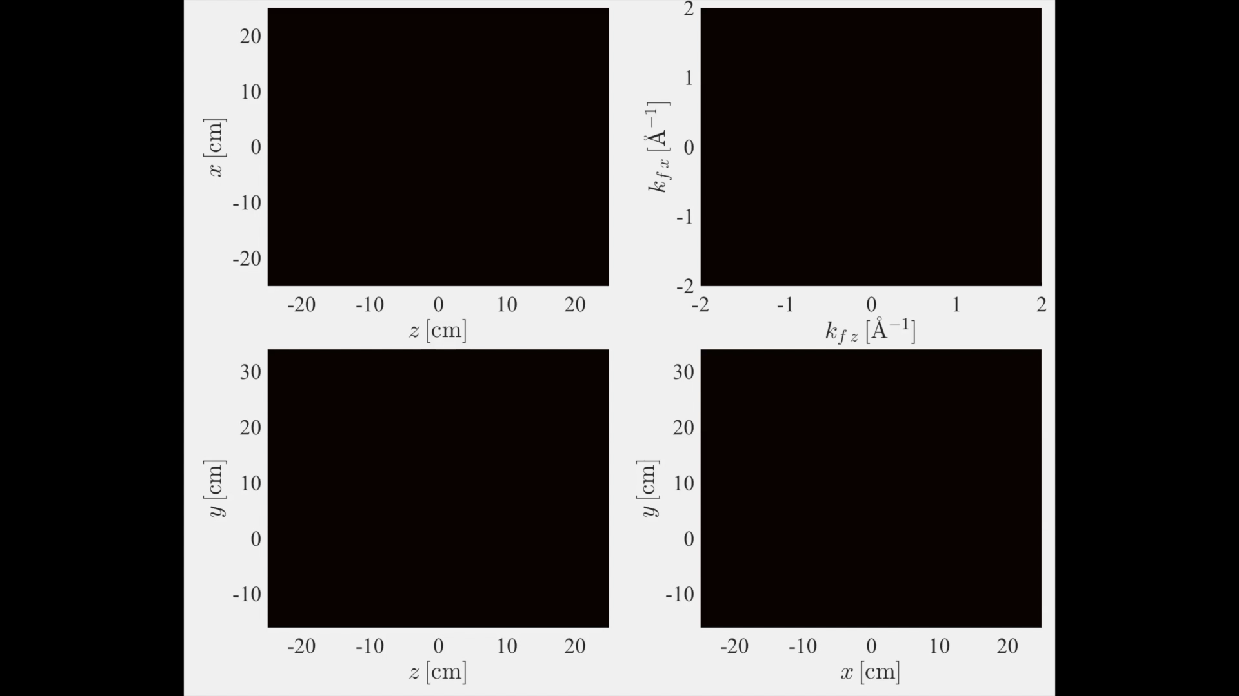

Slide 35

Conditional components
Limiting logger components to record interesting neutrons
Wish to understand how individual background features arose
This project has received funding from the European Union’s Horizon 2020 research and innovation programme under grant agreement No. 823852

Slide 36
Conditional components
Limiting logger components to record interesting neutrons
Conditional components set up some condition upon the final neutron, such as if it hits a certain area
Conditional components modify existing loggers with target_loggers
Can specify many loggers with comma separated list
Current conditionals
Union_conditional_PSD
Union_conditional_standard
COMPONENT scattering_zx = Union_logger_2D_space( D_direction_1 = "z", D1_min = -0.15, D1_max = 0.15, n1 = 300, D_direction_2 = "x", D2_min = -0.15, D2_max = 0.15, n2 = 300, filename = "scattering_zx.dat") AT (0,0,0) RELATIVE sample_position
COMPONENT conditional_psd = Union_conditional_PSD(
xwidth = 0.02, yheight = 0.02,
time_min = 2E-6, time_max = 8E-6
target_loggers = ”scattering_zx”)
AT (0,0,1) RELATIVE sample_position

Slide 37
Conditional components
Limiting logger components to record interesting neutrons
Wish to understand how individual background features arose
This project has received funding from the European Union’s Horizon 2020 research and innovation programme under grant agreement No. 823852

Slide 38
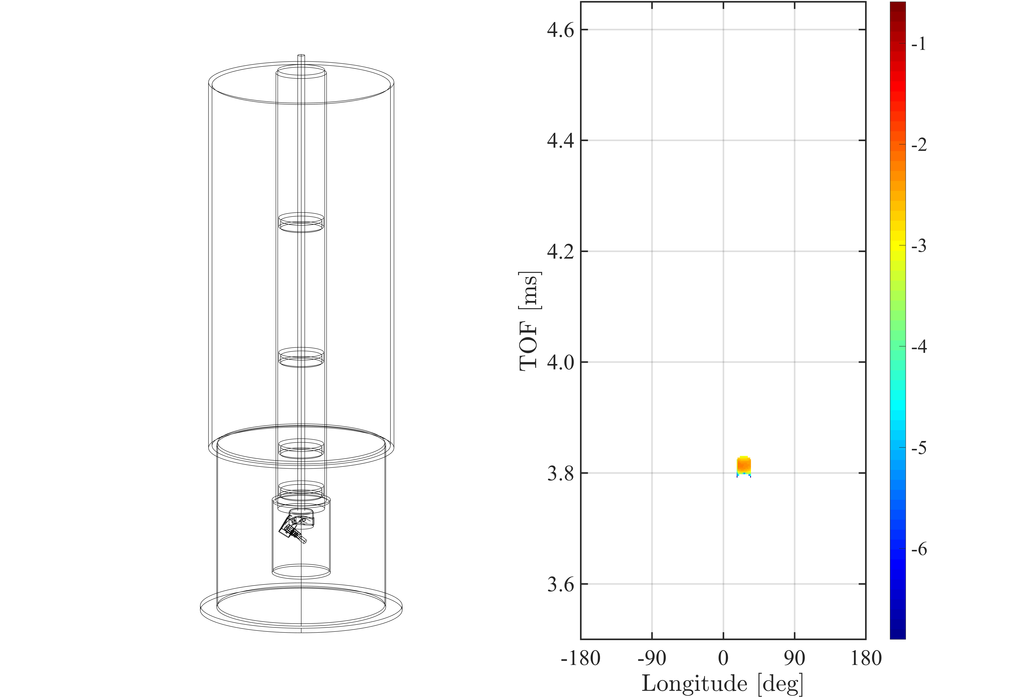
Conditional components
Limiting logger components to record interesting neutrons
Wish to understand how individual background features arose
Select subset of output to be recorded in loggers using Union conditionals
This project has received funding from the European Union’s Horizon 2020 research and innovation programme under grant agreement No. 823852

Slide 39
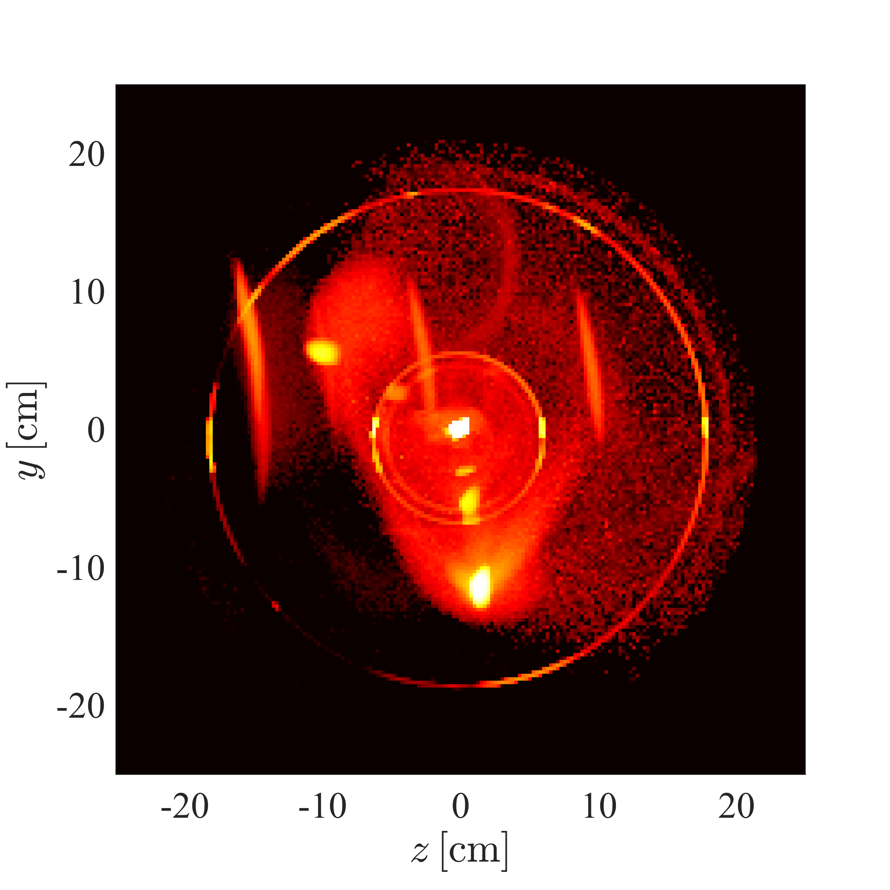
Conditional components
Limiting logger components to record interesting neutrons
Can limit the events that are recorded to the logger using conditionals
Here only rays that contribute to the chosen background problem is seen
Spatial distribution of scattered intensity
This project has received funding from the European Union’s Horizon 2020 research and innovation programme under grant agreement No. 823852

Slide 40
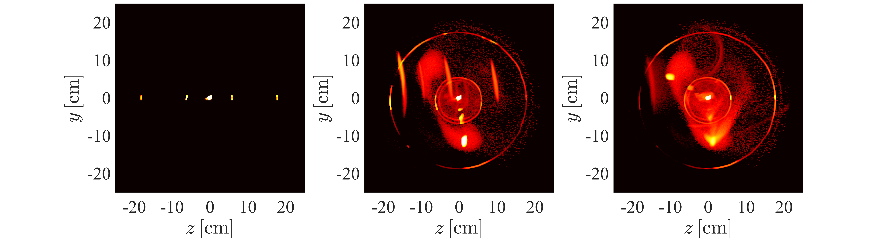
Conditional components
Limiting logger components to record interesting neutrons
All
The different scattering orders makes it easier to draw conclusions
The sample is clearly involved
1
2
3

Slide 41
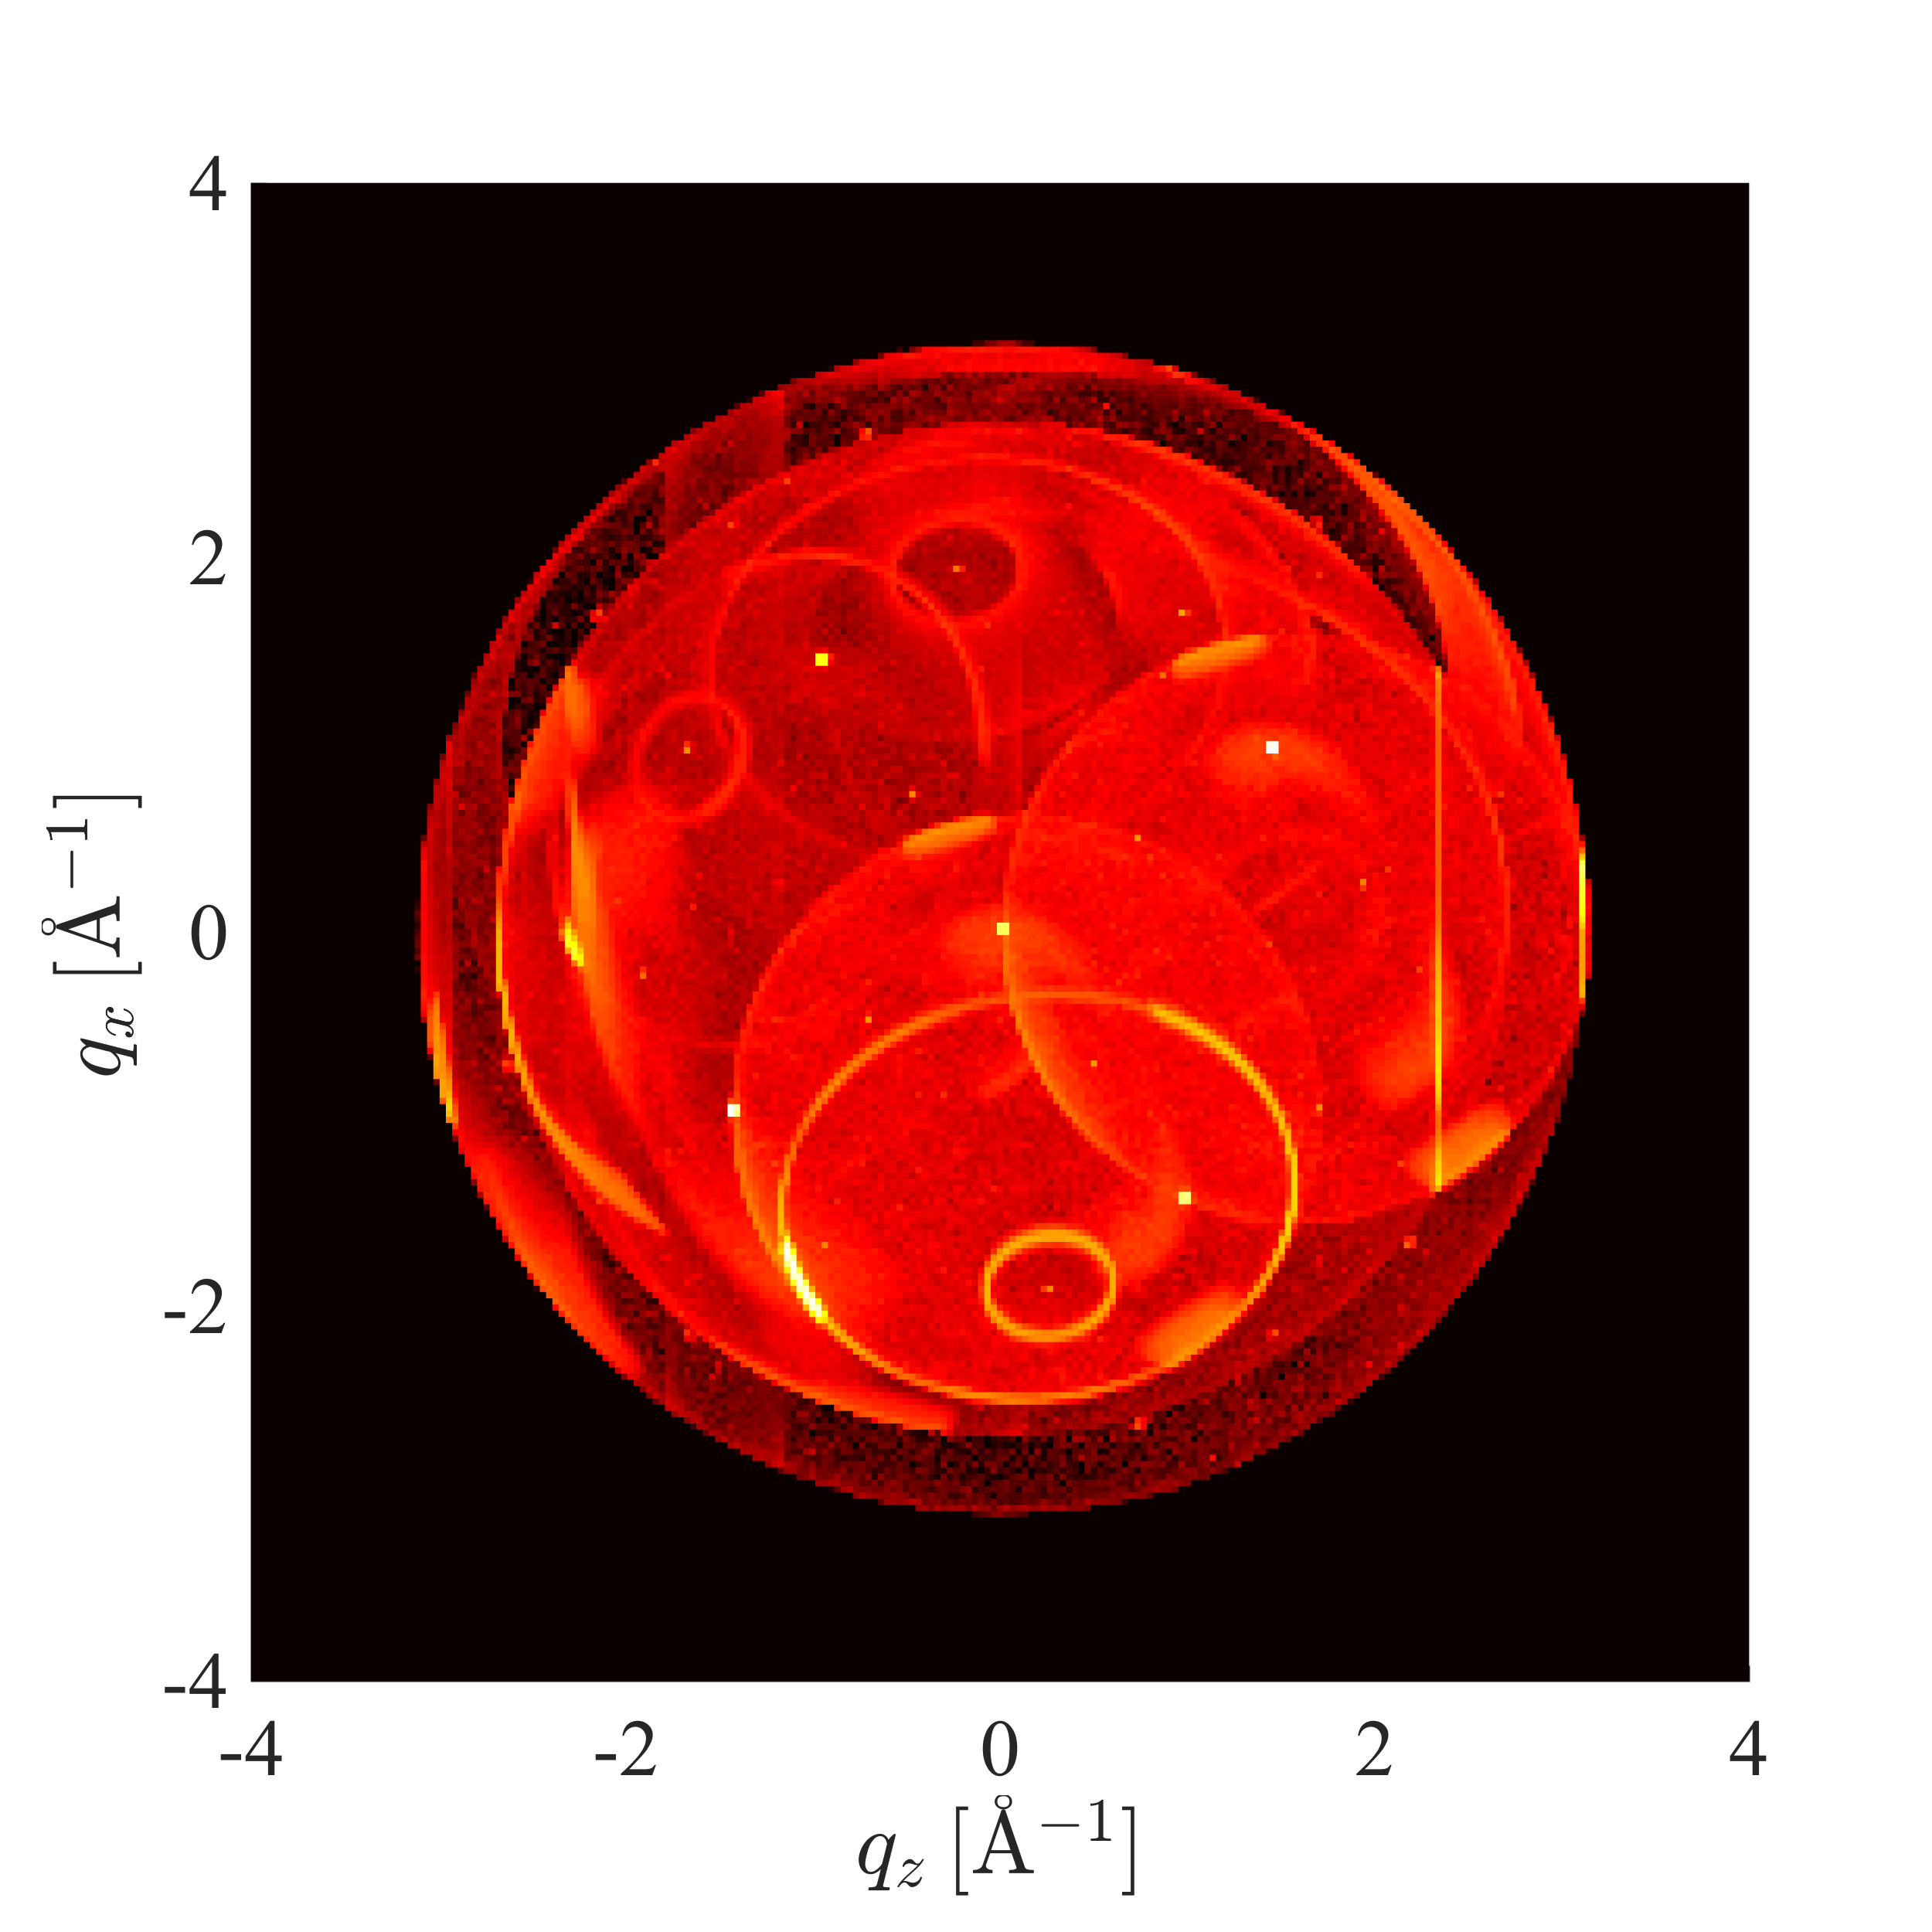
Conditional components
Limiting logger components to record interesting neutrons
Scattering vectors of rays that contribute to the chosen background problem
This project has received funding from the European Union’s Horizon 2020 research and innovation programme under grant agreement No. 823852

Slide 42
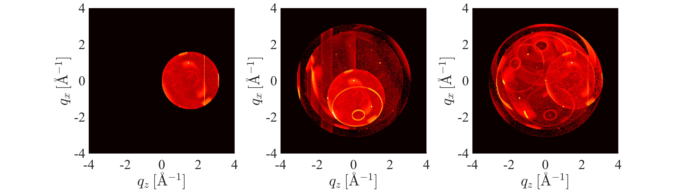
Conditional components
Limiting logger components to record interesting neutrons
All
The different scattering orders makes it easier to draw conclusions
Single crystal Bragg peak to powder Debye Scherrer cone
1
2
3

Slide 44
Summary
Union components allow simulation of complex physics and geometry
Full multiple scattering simulation provides surprising level of detail
The modular nature makes it easier to expand
New geometry with a geometry component (Master project contributed cone and CAD)
New process component to add new physics
Full tutorial available in McStasScript format!

Slide 45
Thanks for your attention
This project has received funding from the European Union’s Horizon 2020 research
and innovation programme under grant agreement No. 823852

